Slide 1
MetaNumber A Proposed Numerical Standardization January 13, 2015 NIST Presentation Part 1 of 2
Joseph E. Johnson, PhD
Physics Department, University of South Carolina
jjohnson@sc.edu

Slide 2
“Numbers serve to discipline rhetoric. Without them, it is too easy for a writer, or a reader, to follow flights of fantasy, to ignore the world as it is, and to remold it nearer to the heart’s desire.”
Ralph Waldo Emerson

Slide 3
MetaNumber Refers to A Numerical Data Ontology
MetaNumber strings, with associated algorithms, provide a formal framework for linking numerical information and supporting all mathematical operations on expressions containing these strings.

Slide 4
Numerical Information (For routine computation, automation, Big Data, & AI)
Numerical Values alone are meaningless without the associated:
Units of measurement
Accuracy level (numerical uncertainty)
Metadata that describes and defines the value
Yet these four components are scattered in
Row & column headings, titles, footnotes, text, or assumed!
They are also unstructured and not computer readable
Human intervention is required to convert to each user’s framework.
This consumes time and is error prone
We need information that is both machine and human readable!
(See printouts)

Slide 5
The Four Problems That Led to this Work

Slide 6
Originating Problem #1: Computation
Accuracy, Units, and Metadata (defining data) are as critical to a measurement as the numerical Value itself
Yet our numbers do not have the (V,A,U,M) information adjoined for holistic computation in each sector:
Our current system does not perform automated unit conversions, statistical analysis, and metadata tracking as part of the evaluation of expressions.
A major problem in numerical analysis is to perform these separate computations and keep the associated information integrated.

Slide 7
The Proposed Solution #1
Computation is automated over full VAUM with four separate but integrated algorithms.
Example: What is the radiation in kilocalories per day of a human assuming an emissivity of 0.527, a temperature of 98.6 F, and an area of 18.81 ft² using dQ/dt = σ∗ε*A*T⁴
With MetaNumber software one can compute the answer as:
>> (sb*0.527*18.81*ft2*(df(98.6))**4) ! (kc/day)

Slide 8
Originating Problem #2: Shared Reference Data
When anyone needs to process numerical data from other groups or published data, they must first translate and convert the units, accuracy level, and defining metadata to their current system before the data can be used:
This is a time consuming, costly, and error prone process.
Computers cannot read current data without our help because the units, accuracy, and metadata are scattered and immersed in text in row and column headings, titles, and footnotes .
This lack of standardization prevents any possibility of true artificial intelligence and automated processing.

Slide 9
The Proposed Solution #2
MetaNumber data tables consist of integrated VAUM data that is readable by both humans and machines instantly.
Every numerical value has a unique name which can be used like a variable in expressions, such as: 3.46*[e_gold_density] which returns the density of gold from the elements ‘e’ table multiplied by 3.46.
Data is cast into tables with unique row and column names as with relational databases with the form: [internet path to server_directory__file name_row name _column name]
The effort required in archiving past data is no greater than the users effort expended on the first use, thus future conversions are without cost.
When invoked with original publication, the effort is zero after the standardization.

Slide 10
Originating Problem #3: Archived Processes & Results
Track the full “geneology” (computational evolution) of every number as it evolves from its origin in sensors and measurements, through all computational modeling, and mergers with other values in order to arrive at the desired distilled information.

Slide 11
The Proposed Solution #3
As each expression is computed, the MetaNumber systems archives: userID, DateTime, Seq#, Subject, Item, ExpressionInput, ExpressionOutput, UnitCode.
The system permits the reuse of all past expressions with [subject_item] for just the evaluated expression, or [subject_item_field] to obtain the other fields.
This allows one to retrace all contributing other values as well as the exact computational model itself.
Software is under development that will retrace the entire tree of evolution of a value.

Slide 12
Originating Problem #4 Personal Units are Needed
Both groups and individual users often need units that are natural to their field of work.
For example astronomers need to use units of the astronomical unit, parsec, lightyear, and the solar mass.

Slide 13
Proposed Solution #4
MetaNumber users can easily define units and constants for their private use such as [my_viscosity_metric1]
This is especially useful in construction, manufacturing, health sciences, engineering, and environmental science.

Slide 14
MetaNumber is:
A browser based computing environment
providing full computational management of:
Units & automatic dimensional analysis,
Numerical uncertainty & error analysis, &
Metadata tags and unlimited metadata,
attached to every numerical value and
automatically computed and tracked.
It has the form:
Value * Accuracy * Units * Metadata
3.4567e5 * z3 * kg/m3
z3 implies there are 3 significant digits
Optional metadata might be: * {K7 Alloy density | temp = 420*k}

Slide 15
Our Objectives:
Define and codify a MetaNumber standard for all numerical values by
attaching accuracy, units, & metadata to every numerical value.
Thus lay a foundation for
Automatic data exchange
Automatic processing of all dimensional analysis & uncertainty
Automatic tracking of all associated metadata and tags
All numeric data to be readable by humans and computers.
Develop this standard to be optimal in space and speed
Notes:
To promote the MetaNumber standardization of all numerical information and thus drastically reduce error and preparation time for the processing and sharing of all numerical information - universally.
To thereby lay the foundation for a new era of artificial intelligence via fully automated processing that eliminates all human preprocessing for intelligent computation.

Slide 16
Rational for Unit Standards:
Case: Modern computer languages use case sensitive variables
The standard is to use lower case
Capitalization of “Named” units is not necessary & confusing
Thus use ampere=amp=a rather than Ampere
Singular: Use the singular form of speech for each unit.
Font: The use of fonts is not uniform among computers and languages
Thus subscript, superscript, Greek, symbol, and special characters can lead to ambiguity when it is not necessary.
Thus use hb rather than ħ, and ohm rather than Ω
Use m3 and m_3 rather than m³ and m⁻³
Our algorithm for dimensional analysis uses units as variables
And follows standard algebraic formats: 3.4*inch+2.1*ft

Slide 17
Unit Names
Are:
always lower case,
ANSII alphanumeric,
in the singular,
without subscripts or superscripts
Without any special or foreign characters (such as Greek Ω or ħ).
Can be mixed in any valid manner.
Metric (SI) units are the returned default.
But (expression) ! (units desired) can return a result in any units desired.
Errors and invalid forms are trapped and flagged.

Slide 18
Metric (SI) basic units are the Default (with allowed abbreviations) are
Length: meter, m
Time: second, sec, s
Mass: kilogram, kg
Current: ampere, amp, a
Temperature: kelvin, k
Luminous Intensity: candela, cd
Auxiliary:
Quantity of Substance: mole
Plane angle: radian
Solid angle: steradian

Slide 19
Optional Additional Fundamental Units
Bit of information (1/0): bit, b
Person: person, p
Value (US Dollar) dollar, usd, d
These three optionally extend the SI system.
About 600 units, constants, prefixes, and abbreviations are contained in the MetaNumber software.
Unlimited additional unit names and constants are listed in the adjoined data tables.

Slide 20
Common Powers of Units
Products and quotients are always valid for all units e.g. 1/(mile*mile).
The metric unit powers can be written m2 = m², m3, m4, m_1 = m⁻¹ , m_2, m_3, m_4 and
Likewise for s, kg, a, k, cd, as well as b, p, d
This same notation is also allowed for some common US customary units: (ft2, ft3, inch2, inch3, …).

Slide 21
Examples
(3.552*ft + 835.2*inch – 0.3*m) ! yard
Gives the evaluated length in yards.
3.8*4.552e4 * z3 * kg*ft_3 * {time=20140921}
z3 signifies there are actually only 3 significant digits.
Metadata links density to the time in the format:
{var 1 = value 1 | var 2 = value 2 |….}
((34.5*acre + 23*m2)*1.81*inch) ! ft3
gives the volume of this area times this depth in units of cubic feet.
If “!ft3” were absent, the result would be given in m3

Slide 22
Rationale for Numerical Accuracy
There are multiple means of expressing numerical accuracy:
Significant digits
Range (flat probability distribution)
Standard Deviation σ (for a normal distribution)
Advanced methods such as bit vectors
We retain all of these as options for the next release
But we always know the number of significant digits
That denotation is universally understood
We rarely know uncertainty as measured in standard deviations
The number of significant digits can be inferred from the number in its original form (before mathematical operations).
Thus we use scientific notation, compute and attach the significant digits in the numbers original form, use z# to denote, and compute the new z# value with each operation yet keep full computational accuracy.

Slide 23
Numerical Accuracy
Is tracked via the significant digits as
Indicated by the value following “z” as multiplying the value:
2.33456*z4 indicates that only four of the 6 digits are valid.
Results are computed at full accuracy and
the user can truncate as desired for significance
z0 indicates only an order of magnitude of significance.
z alone indicates an exact value (e.g. the speed of light)
Special Values:
z00 indicates a missing value, infinite uncertainty

Slide 24
Rationale for Metadata
Data values are usually grouped in a list (such as NIST’s list of fundamental constants) or in a table labeled by row and columns names. If not, then it can be put into that form.
Consider a table name ‘e’ of the chemical elements:
One can reference any value with [e_rowname_columnname]
Thus the density of carbon is denoted as [e_carbon_density]
We use the structure of a relational database indexing.
%% | %%Symbol | %%AN | Atomic Weight | Density
%Units |  |  | u | gram/cm3
%metadata
Hydrogen | H | 1 | 1.00794*u*{u=7} | 0.00008988*gram/cm3
Helium | He | 2 | 4.002602*u*{u=2} | 0.0001785*gram/cm3
Lithium | Li | 3 | 6.941*u*{u=2} | 0.534*gram/cm3
Beryllium | Be | 4 | 9.012182*u*{u=3} | 1.85*gram/cm3
Boron | B | 5 | 10.811*u*{u=7} | 2.34*gram/cm3
Carbon | C | 6 | 12.0107*u*{u=8} | 2.267*gram/cm3

Slide 25
Metadata Rationale (cont.)
By insuring that the file, row, and column names are unique, then this gives a unique name to this MetaNumber value.
Preceding a row or column name with “%” indicates it contains only metadata.
If it is preceded by a “%%” then the metadata is unique and can be used as an index for that row or column.
The first row and column are always unique metadata fields and values which apply to the associated row and column.
This method allows one to insert any number of rows or columns of any form of metadata in the table (indicated by a ‘%name’ ).
This metadata could be web links, photos, any form of data.

Slide 26
Now by virtue of the short name [file_row_column], one not only points uniquely to the value but also by inference to all associated metadata.
We then adjoin two more rows of data to the top that serves as metadata for the entire table (row 1 =variable, row 2 = value).
Both z# and {….} evaluate to ‘1’ (unity) and thus can multiply any value without changing it.
They are both ‘carriers’ of the associated significant digits and metadata information.

Slide 27
MetaNumber System Implementation
Accessed at www.MetaNumber.com for user registration using ones email as user name.
A browser based cloud computational system with no downloaded software.
Operated with any internet device (smart phone/iPhone, tablet / iPad, or PC).
Created & programmed in Python by Joseph E. Johnson
Converted to a server based system by the USC Research Cyberinfrastructure Group

Slide 28
Computational Environment
Running on multiple servers with quad processors, each with a 60 node 1 Teraflop Xenon Phi Coprocessor.
Housed in the secure USC UTS central computing facility with dual 10GB IP connectivity.
Fiber speed access to a 100 Terabyte storage facility.
Intellectual property protected under pending patent, copyright, and trademark laws.
The MetaNumber design includes the proposed 2014 changes in the SI (metric) foundational units that is to be implemented in 2018.

Slide 29
Current MetaNumber Status
System is operational on our new server at MetaNumber.com
Unit and metadata components fully operational
With about 700 internal units and constants and 26 tables
Operational tracking of past results and user defined units
Some user web information, brochure, and examples on line
10 Senior faculty and 12 students active on the project
Under development – expect completion by May/June
Algorithm for computing significant digits
Program to assist in table creation
Extensive user tools to view table data and ones past usage
Promotional material and proposal submission
Seeking: Consultation with NIST and
New Federal Funding in multiple domains.

Slide 30
Mathematical Foundations of Networks With Cluster Identification January 13, 2015 - NIST Colloquium – Part 2 of 2
Joseph E. Johnson, PhD,
Physics Department University of South Carolina
Columbia SC 29208 USA

Slide 31
Consider Two Very Fundamental Problems: The Understanding, Classification, and Analysis of:
Mathematical Networks:
Networks include those for information, communication, transportation, financial & trade, utility, health & social networks.
Information and Clustering:
Clustering in networks and systems of “similar things”
These two domains are two of the most difficult areas in mathematics.
This talk will explore common roots of both of these concepts with both Lie algebras & Lie groups, and with Shannon & Renyi entropy metrics
I will then link this work with that on MetaNumbers

Slide 32
Math Preliminaries Vector Spaces Lie groups and algebras, Markov Transformations
Linear Vector Space (LVS): |A>+|B> = |C> and a|A> = |B>
A basis |i> for the space gives all elements as |A> = a_{i} |i>
LVS becomes more powerful with the following two products:
Metric Space (MS) A*B = ΣA_{i}B_{i} = real # = |A| |B| cos θ
So we get the ‘metrics of length and angle.
Examples: regular space and the unitary scalar product
Lie Algebra (LA) [L_{i}, L_{j}] = c_{ij}^{k} L_{k} & the Jacobi Identity
Lie Group : G(q) = e^{qL} = 1 +tL + t²L²/2!+…
LA Examples: Rotation Σx_{i}², Translation x’_{i}=x_{i}+a_{i}, Lorentz c²t²-r², Poincare (Lorentz with translations), Unitary ΣΨ_{α}∗Ψ_{α}=1, General Linear x’_{i} = G_{ij} x_{j}, Markov Σx’_{i} = Σx_{i}, Scaling x’_{i}=e^{li}x_{i} & Heisenberg X, P, .
LA Representations: LA can often be represented by matrices acting upon vectors in a metric space.

Slide 33
Information & Entropy
Information is Defined by the Log of the Probability
Bits of information 1 & 0
Information (order) is the inverse of Entropy (disorder)
If the probability is large at a place then we know where something is and thus have more information.
Information is additive but probabilities are multiplicative.
Thus I is a log of P and Shannon defines: I = Σ P_{i} log₂ P_{i}
Renyi’ I = log₂ (2Σ P_{i}²) or generally: S(a) = (1/(1-a)) log₂ (Σ P_{i}ª)
1 / 0 state: I = log₂ 2(1²+ 0²) = log₂ 2 = 1
½ / ½ state: I =log₂ 2 ((1/2)² + (1/2)² ) = log₂ 1 = 0
There is no formal mathematical definition a “cluster” but intuitively it is a grouping of similar entities.
There are over 100 algorithms for clustering in networks
Yet the concept of a “cluster” is the foundation of our language.

Slide 34
Markov Process We Know
Markov Transformations have, for 100 years, described diffusion (random walks) and thus increasing entropy.
Markov transformations preserve the sum of the components of a vector (normally representing a probability or the numbers of things in different categories.
Diffusion & entropy are described by Markov Transformations X’=Mx with Σx’_{i} = Σx_{i}
These are motions over a plane perpendicular to the vector (1, 1, 1, ….1) and in the positive quadrant.
Discrete Markov transformations (Markov chains) have extensive utility.
We discovered a linkage between continuous Markov transformations and Lie algebras and groups.
This is important because the Markov group is the mathematical representation of increasing entropy (thus of information loss).

Slide 35
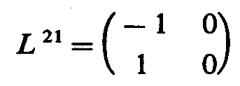
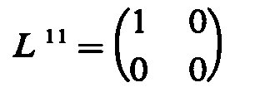
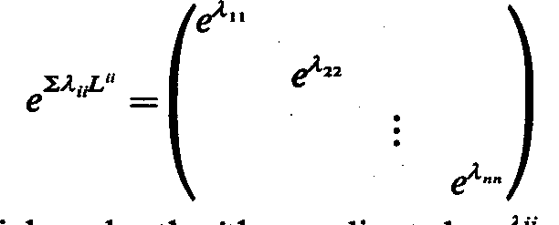
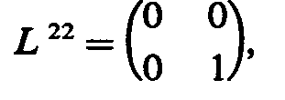
Decomposition of the General Linear Group
GL(n,R) contains all the previous Lie algebras (LA) & groups:
We discovered a new decomposition into a Markov Type (MT(n²-n) ) LA and Abelian scaling (A(n)) LA
The Markov and scaling Lie algebra generators are:

Slide 36
More Specifically:
Markov Type LA constrained to Markov Transformations gives the Markov Monoid MM
This connects Lie Algebras and Lie Groups with Diffusion, Random walks, Entropy and Information
Here we see the identity for λ =0 and equilibrium with total diffusion at λ = infinity

Slide 37
The Markov Monoid
But in order to preserve the positive definiteness of the components, it is necessary and sufficient that the a parameters are all non-negative.
This removes the inverse of the Markov type transformation and leaves us with a Lie Monoid.
Note that the diagonal elements are necessarily the exact negative of the sum of the off-diagonal elements in each column.
Thus we have linked Lie algebras and Lie groups with continuous Markov transformations – This allows the power of each domain of mathematics to inform the other.

Slide 38
Networks: A Mathematical Foundation

Slide 39
Networks Defined
A network is a set of points called nodes numbered 1,2,..,n which are connected with some ‘strength’ C_{ij} which is an n x n matrix of non-negative numbers.
However the diagonal is missing, not zero – missing! because there is no meaning for the connection of a thing to itself.
Thus the eigenvector/eigenvalue analysis and other tools of linear algebra cannot be used.
The numbering of nodes has no natural order thus there are n! C matrices that describe the same network
It is thus extremely difficult to compare two networks or to compare a network to its previous state.

Slide 40
Major Result of our DAPRA Research
Every network C will exactly define the Lie monoid generator with its off diagonal elements.
Conversely, the Lie monoid generator then defines the C diagonals.
Thus every network C is isomorphic to a Markov monoid generator L
Thus every network C_{ij} generates a one parameter family of Markov transformations; M(a) = exp(a C).

Slide 41
Furthermore, A Static Network Generates Markov Flow “Model”
Now given any C we can construct the Markov Monoid L and generate the continuous Markov transformation M = exp(t L).
This generates flows among the nodes in proportion to their network connectivity which conserve the sum of the elements acted upon (money, fluid, ..).
The Markov transformation has columns which are non-negative and sum to unity and can be interpreted as a probability distribution.
Thus they support a definition of Renyi (or Shannon) entropy for each node.
These entropy values can be sorted to give an order to the nodes and represent the topology uniquely by an entropy spectral curve.

Slide 42
Our Previous Results
The isomorphism of every network to a Lie Markov monoid now integrates four branches of mathematics:
Lie algebras and groups - Markov theory – Networks - Entropy
One can now define the distance between two networks (or a network at an earlier and later time) using the Renyi spectra.
We were able to show that the Renyi entropy spectral curve revealed aberrant changes in a network topology showing changes over time (networks attacks, failures, misuse).
Our software allowed one to click on altered portions of the spectral curve and identify the specific aberrant nodes.

Slide 43
Two Critical Remaining Problems:
We first sought to expand a network as a series of sequentially less important terms thus capturing the topology primarily in the first few terms (as series expansions are used mathematically like Fourier series).
We also sought to find a method of identifying clusters in a network in a way that did not entail arbitrary definitions but which was purely mathematical.

Slide 44
Problem 1: An Expansion of the Topology as a Series
We realized that each of the Renyi entropies was a higher power of the Markov column components and thus they were all functionally independent.
Furthermore each entropy spectral curve was smaller than the preceding entropy order.

Slide 45
Differences of Successive Orders of Renyi Entropies
We realized that if we defined the higher order Renyi entropies on each column then these entropies would be functionally independent as each was the log of the sum of higher powers of the terms.
Also, as each spectral curve is less than the previous, it follows that the differences between two successive orders becomes smaller very rapidly .
Thus this sequence, of differences of Renyi entropies of successive orders, constitutes a rapidly decreasing series of curves that contain all of the topological information of the network and thus serve as the expansion that we sought: complete and rapidly decreasing.

Slide 46
The same process can be executed on the rows.
As there are n*(n-1) independent values in the network topology, and since each column and row collectively provide 2n, this requires (n-1)/2 orders of Renyi entropies.
These curves can be used to monitor anomalous changes in a network: attacks, failures, and the differences between any two networks.
As these Renyi entropy curves contain all the topological information, they also have the potential to serve as a foundation for the classification of networks.

Slide 47
Problem 2: The Cluster Identification Problem
We studied the meaning of the eigenvector / eigenvalue solutions for the Markov transformation in view of the model of the conserved flows.
We realized that flows were faster within clusters in approach to equilibrium
We also realized that the eigenvectors described those combinations of nodes that approached equilibrium at the exact rate of the associated eigenvalue. – like normal modes of oscillation in physics.
It follows that those nodes that are more tightly bound (as represented by the eigenvalue combination of nodes) have a flow that is more rapid (as represented by the eigenvalue)

Slide 48
Results
Thus the entire cluster analysis is displayed in the eigenvectors as each eigenvector is a linear combination of the nodes that reveals the clustering.
Furthermore, the strength of the clustering is collectively measured by the magnitude of the eigenvalue.
Furthermore, the exp(aC) expansion is Markovian for any number of terms of expansion of the Lie algebra where the number of terms gives the degree of separation.
The eigenvector structure (and thus the cluster information) are slightly different for the different numbers of terms used for the exp(aC) expansion.
Yet there can be no formal proof as there is no exact definition of clustering! We must see if we can revel hidden clusters with real world networks.

Slide 49
Network Analysis Summary:
Thus the entire network topology is captured in both methods of network analysis:
The (n-1)/2 successively smaller nested Renyi entropy spectral curves contain all of the topology in increasingly less important terms.
These measure the n^{th} order entropy of incoming and outgoing connections for each node.
The n eigenvectors of the Markov matrix, each with n components, sorted by the order of the eigenvalues as a metric of the degree of clustering, likewise provides a complete description of the topology.
These measure the clustering structure in the network.

Slide 50
Applications to Simulated Networks
We created a network with clusters within clusters by using larger values of the connection matrix in successive layers and scrambled the nodes.
We computed the eigenvalue and eigenvectors which instantly revealed the anticipated cluster structure.
As there is no formal definition of clustering, there is no way to prove this hypothesis but our observations confirm what one intuitively can see by the solution as well as by the underlying Markov model.
Notes:
Since the Markov matrix M can be thought of as modeling an imaginary flow
among the nodes, Johnson conjectures that the eigenvalues and eigenvectors of this
matrix can be useful in discovering clustering structures within networks [5]. The
basis of this conjecture is that the flows modeled by the Markov matrix, generated by
the modified connection matrix, has eigenvalues that represent linear combinations
of nodes which collectively approach equilibrium at the rate of the corresponding
eigenvalue and achieve this with flows among those participating nodes [5]. That
hypothesis is tested with two sample networks. They are both 10-node networks
with 3 main clusters (see Figure 4.1). In the first, the intracluster connections are
all the same strength with the connections between the clusters much weaker. The
second network is the same except for the fact that the 5-node cluster has a 3-node
cluster within it (nodes 0, 1, and 2 are more strongly connected than the others).
The eigenvectors and eigenvalues for the M matrix are calculated and then analyzed.

Slide 51
A network that has a cluster embedded within a cluster gives these eigenvalues:
Eigenvalue: 0.882491186839: Included nodes: [0, 1, 2]
Eigenvalue: 0.882491186839: Included nodes: [1, 2]
Eigenvalue: 0.926438963526: Included nodes: [0, 1, 2, 3, 4]
Eigenvalue: 0.926556991774: Included nodes: [0, 1, 2, 4]
Eigenvalue: 0.955737589687: Included nodes: [5, 6, 7]
Eigenvalue: 0.955934195065: Included nodes: [5, 7]
Eigenvalue: 0.970549538208: Included nodes: [8, 9]
Eigenvalue: 0.999846933025: Included nodes: [0, 1, 2, 3, 4, 5, 6, 7, 8, 9]
Eigenvalue: 0.999953415037: Included nodes: [0, 1, 2, 3, 4, 5, 6, 7, 8, 9]
Eigenvalue: 1.0: Included nodes: [0, 1, 2, 3, 4, 5, 6, 7, 8, 9]
Notes:
For example, for the uniform 10-node network, the following eigenvalues result:
0.99981417975, 1.0, 0.999943446785, 0.964247727554, 0.946266317865, 0.910698370842,
0.946504992867, 0.910841654779, 0.910841654779, 0.910841654779. The corresponding
eigenvectors all have nonzero elements. Looking at one such eigenvector, the
relative magnitudes of the components describe how strongly connected the nodes
are to the cluster associated with the corresponding eigenvalue. So a relatively high
magnitude for component j of eigenvector i implies that node j is a member of the
cluster associated with eigenvalue i. In order to make the prominent member nodes
for a particular cluster more apparent, all eigenvector components below a certain
cutoff value can be set to zero. To do this, first the maximum component magnitude
22
for all of the eigenvectors is found. The cutoff value is then calculated by multiplying
the threshold value, in this case 0.3, by that maximum component magnitude.
Then all of the eigenvector components with magnitudes less than that of the cutoff
value is set to 0. After doing that, the prominent components of the individual
clusters is much more apparent to the eye. For example, the minimum eigenvalue,
0.910698370842 corresponds to the eigenvector
0

Slide 52
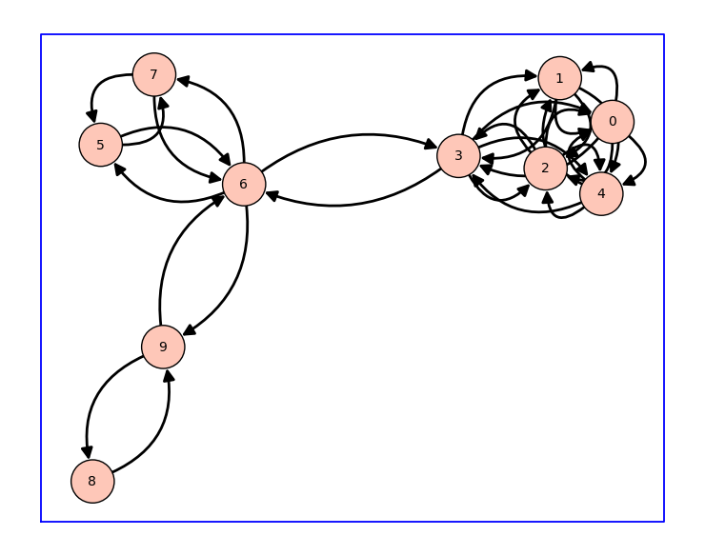
Show C and its Eigenvectors: 10-Node Cluster Network: 3 clusters

Slide 53
Eigenvalue analysis summary
There is a strong indication that the eigenvalues are pointing out the clusters in order of strength
The associated eigenvectors indicate which nodes are members of the cluster

Slide 54
Network 1 Extended Results
Eigenvalue: 0.910698370842:
Included nodes: [0, 1, 2, 3, 4]
Eigenvalue: 0.910841654779:
Included nodes: [0, 1, 2, 4]
Eigenvalue: 0.910841654779:
Included nodes: [1, 2, 4]
Eigenvalue: 0.910841654779:
Included nodes: [1, 2, 4]
Eigenvalue: 0.946266317865:
Included nodes: [5, 6, 7]
Eigenvalue: 0.946504992867:
Included nodes: [5, 7]
Eigenvalue: 0.964247727554:
Included nodes: [8, 9]
Eigenvalue: 0.99981417975:
Included nodes: [0, 1, 2, 3, 4, 5, 6, 7, 8, 9]
Eigenvalue: 0.999943446785:
Included nodes: [0, 1, 2, 3, 4, 5, 6, 7, 8, 9]
Eigenvalue: 1.0:
Included nodes: [0, 1, 2, 3, 4, 5, 6, 7, 8, 9]

Slide 55
Network 2 (cluster within a cluster)
Eigenvalue: 0.882491186839:
Included nodes: [0, 1, 2]
Eigenvalue: 0.882491186839:
Included nodes: [1, 2]
Eigenvalue: 0.926438963526:
Included nodes: [0, 1, 2, 3, 4]
Eigenvalue: 0.926556991774:
Included nodes: [0, 1, 2, 4]
Eigenvalue: 0.955737589687:
Included nodes: [5, 6, 7]
Eigenvalue: 0.955934195065:
Included nodes: [5, 7]
Eigenvalue: 0.970549538208:
Included nodes: [8, 9]
Eigenvalue: 0.999846933025:
Included nodes: [0, 1, 2, 3, 4, 5, 6, 7, 8, 9]
Eigenvalue: 0.999953415037:
Included nodes: [0, 1, 2, 3, 4, 5, 6, 7, 8, 9]
Eigenvalue: 1.0:
Included nodes: [0, 1, 2, 3, 4, 5, 6, 7, 8, 9]

Slide 56
New Idea: Could Tabular Data Also be Clustered by Converting it to a Networks?
We were also working on the MetaNumber project that involved rows of entities like elements or compounds with columns that numerically measure a large number of their properties – like the periodic table of the elements.
Some entities are “closer to other entities” in the sense that their spectra of properties are more similar such as copper to silver or iron to cobalt.
Could tabular data be clustered by forming a network?
We created such a network C based upon statistical closeness defined by C_{ij} = exp( -Σ_{k}( T_{ik} –T_{jk} )² )

Slide 57
Calculating the elements of C_{ij}
Each property of entity i is compared to the corresponding property of entity j
The norm and standard deviation of each property was calculated and each column was rewritten in dimensionless form as the number of standard deviations from the norm which was reset to zero for that column.
This was done to each column.
We computed C_{ij} = exp( -Σ_{k}( T_{ik} –T_{jk} )² ) and as before set the diagonal terms to be the negative of the sum of the non-diagonal terms in each respective column.

Slide 58
Testing the procedure
A threshold value is set to make it easier to see the strongest connections
Every element below a certain percentage of the max value is set to 0
This example uses a table of 103 elements with 21 physical properties
The strongest 3% of the connections are shown (from strongest to weakest: blue, green, and red)

Slide 59
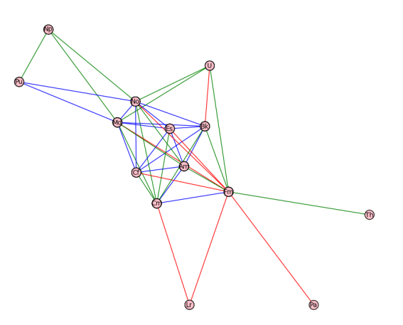
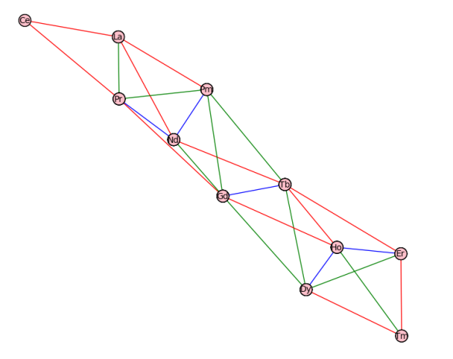
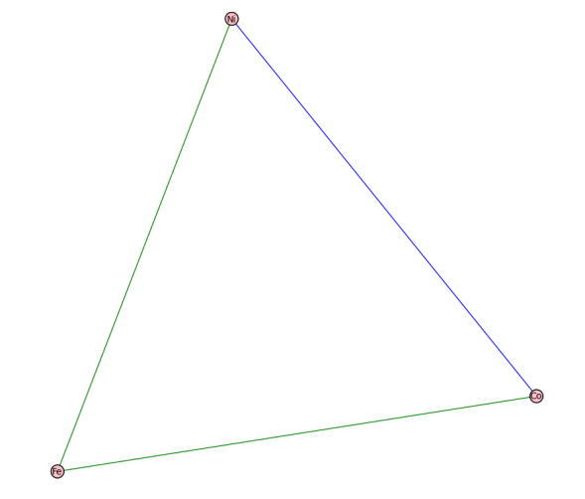
Strongest connections

Slide 60
This then allowed us to study the network and associated clustering as previously defined.
Even using the physical properties of the elements (as opposed to chemical properties) we obtained clustering that is reflective of our intuitive sense of the clustering of elements (such as the iron/cobalt/nickel cluster) .
The work as just described was executed by Mr. William Campbell who just obtained his M.S. in Physics at USC and performed the calculations and associated analysis for his thesis.
He used Phython, NetworkX, and Sage (which includes SciPy and Numby) for this work.

Slide 61
Current Research Status:
We are in the process of writing code to perform these Renyi entropy and eigenvector/eigenvalue cluster analysis on the high speed MetaNumber server, writing the code in Python with Sage, SciPy, Numby, and other Python compatible software. This time we seek to have this entire process automated for a user to submit a network or table.
The system will allow a user to (A) submit a network (C matrix) as a Comma Separated Value (CSV) file (which can be created in Excel, and obtain the clustering structure via the eigenvectors of the Markov generated matrix.
Likewise, a user can (B) submit a rectangular table of properties of entities and obtain the same analysis.
Currently we are seeking funding to assist in this project. We believe that such an environment would be of vast use!

Slide 62
The Network/Cluster Algorithms with MetaNumber – more linkages:
There is a unit code generated in MetaNumber that creates a network linkage among all units of the same type both in archived tables and user historical expressions.
This network links different users with a connectivity determined by their usage of the same units such as viscosity.
Such a network display the linkages among scientists or commercial entities based upon shared interest (same units used)
Networks can also be formed from metadata tags
In each of these cases, the determination of clusters can be automated and the dynamics of changing relationships be display to see scientific and commercial trends in these clusters.
Other software is in the design phase relating to equations.

Slide 63
I Thank You for this Opportunity I would welcome the opportunity to further discuss and explore both research areas with NIST scientists.
Joseph E. Johnson, PhD
Distinguished Professor Emeritus
Department of Physics, University of South Carolina,
Columbia SC, 29208, USA
Email: jjohnson@sc.edu
Cell: 803-920-1229

