Slide 1
Recent Advances in Computational Methods for the Solution of the Time-Dependent Schrödinger Equation
B. I. Schneider
Applied and Computational Mathematics Division
National Institute of Standards and Technology
Gaithersburg, MD 20899-8910, USA
December 16, 2014

Slide 2
Basic Equation
Where

Slide 3

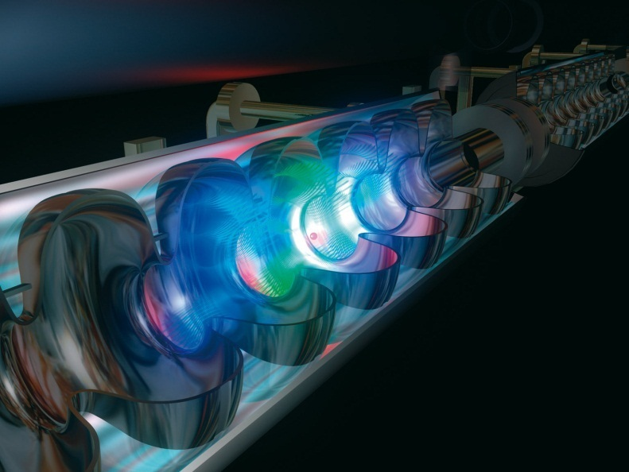
What Motivates Our Interest
Novel light sources: ultrashort, intense pulses
◻ Nonlinear (multiphoton) laser-matter interaction
Attosecond pulses
probe and control electron dynamics
XUV + IR pump-probe
Free electron lasers (FELs)
Extreme intensities
◻ Multiple XUV photons

Slide 4

What are the (my) Computational Requirements for a Robust and Flexible Numerical Method
Basis/ grid – capability to represent dynamics on small and large scale
Good Scaling Properties - O(N)
Matrix elements easily computed
Time propagation stable and unitary
“Transparent” parallelization

Slide 5
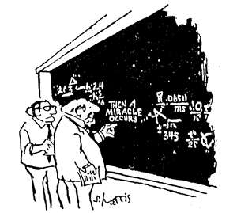



Classical Orthogonal Functions and Gauss Quadratures
Orthonormality with respect to a positive weight function
Just polynomials
A simple three term recursion relationship
Holds for finite N
over Gauss quadrature
points
Completeness
Gaussian quadrature points and weights are easily found by diagonalizing the tri-diagonal matrix of

Slide 6
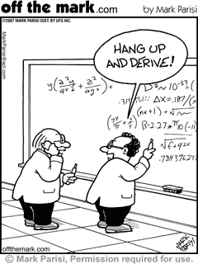
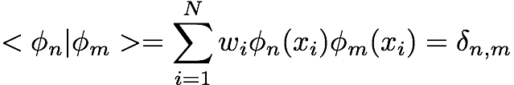
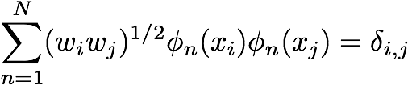
Properties of Classical Orthogonal Functions
Since the Gauss quadrature points are the zeros of the (N+1) orthogonal function, it follows;
Discrete Orthonormality
Discrete Completeness

Slide 7


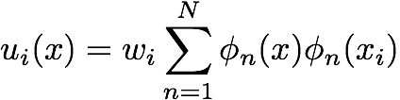
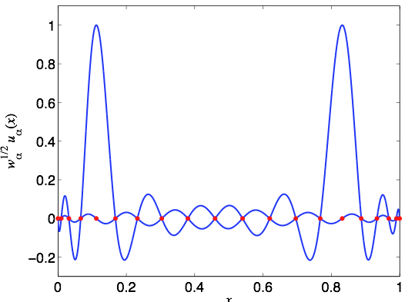


What is a DVR Basis ?
Define a new set of “coordinate” functions
with the property
Legendre DVR
and
The DVR makes the approximation that;
This has been shown to be accurate provided the basis ( quadrature ) is large enough.

Slide 8
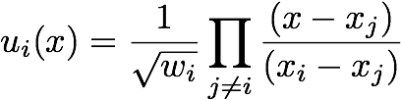
DVR Basis
By definition it also follows;
Lagrange interpolating polynomials normalized on the integration mesh
Often specific functions need to be dropped to satisfy boundary conditions at the end points

Slide 9

Other Types of DVR Basis
* Sinc Functions
* Particle in a box
* Cylindrical and Spherical Bessel Functions
*Any set of functions having a simple set of zeros ?
BUT DVR’s based on classical orthogonal functions are especially accurate as a consequence of the Gauss quadrature rule

Slide 10


Properties of Operators
Matrix Elements “Simple” for Local Operators if DVR Quadrature Rule Valid
Kinetic Energy Matrix Elements Evaluated Either Analytically or Via Quadrature Rule
* an example in cartesian coordinates but similar for all systems

Slide 11
Short Digression for the Cognoscenti
For H_2 in prolate spheroidal coordinates
The volume element in this coordinate system
renders all matrix elements numerically benign
One basis (quadrature) to rule them all
The Legendre functions have sqrt singularities that make the DVR non-polynomic. They are explicitly removed!

Slide 12
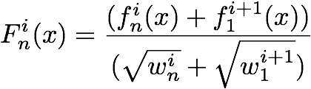
The Finite Element DVR Basis
Properties
* Each coordinate divided into elements of arbitrary size
* Each element has an arbitrary number of DVR functions but the objective is to use the minimal number for the accuracy required
* Only function continuity enforced at the element
boundaries
Gauss-Lobatto quadrature rule - Common end points
1 Sparse representation
2. Spectral Accuracy
3. Matrix elements trivially constructed from subelements

Slide 13
FEDVR Matrix Structure in one dimension
×
×
×
×
×

Slide 14
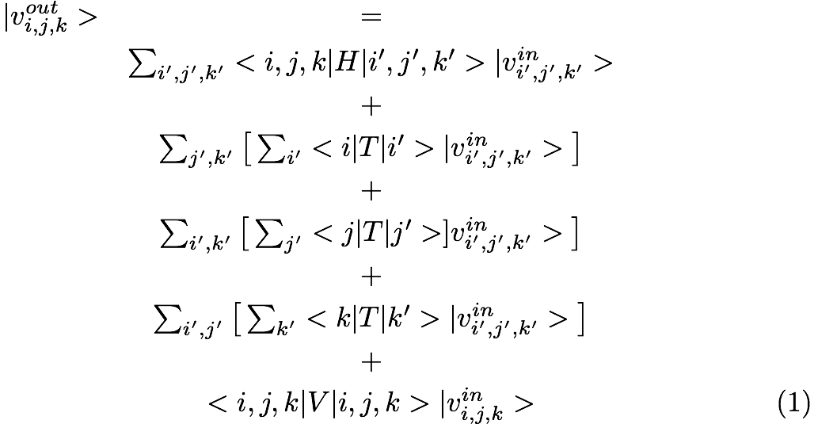

Matrix Multiply - Nested Sums
=
O(N) operations

Slide 15
Getting it Right for a Simple Case-Eigenvalues of H Atom using 40 Legendre
DVR Functions

Slide 16
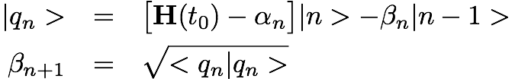
Time Propagation Methods
* Short Iterative Lanczos
Diagonalize Hamiltonian in Krylov basis
Few recursions needed for short time- Typically 10 to 20 via adaptive time stepping
Unconditionally stable
Major step - matrix vector multiply, a few scalar products and
diagonalization of tri-diagonal matrix

Slide 17
Time Propagation Methods
* Split Operator – Second order accurate
Unitary
Unconditionally stable
Higher order versions available and easily
implemented
Need to evaluate exponentials

Slide 18
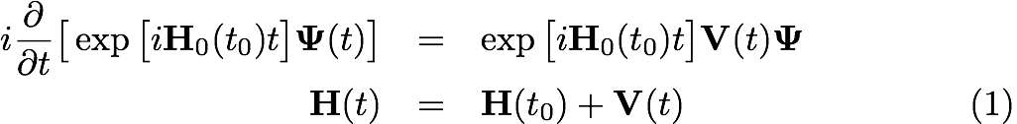
Time Propagation Methods
* Generalization: Exponential Propagators (work in progress)
Integrate from t0 ➔ t0 + δt
Approximate integral using quadrature
Develop explict, implicit or Runge-Kutta schemes

Slide 19
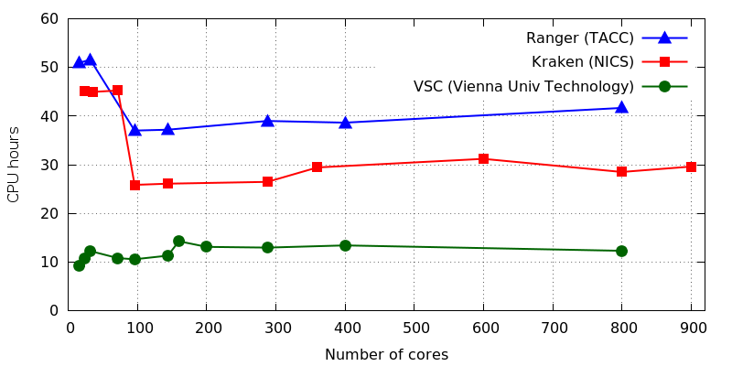
Putting it together
NR₁ NR₂ Angular
Linear scaling with number of CPUs
Limiting factor: Memory bandwidth

Slide 20
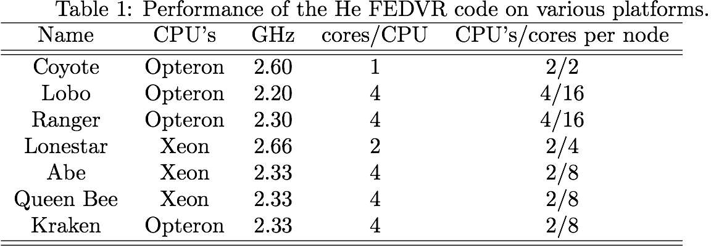
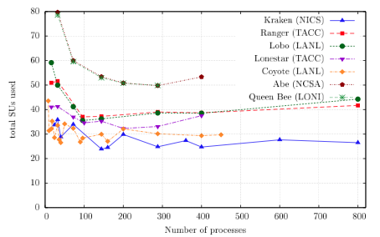
Performance on Various Mutiprocessors

Slide 21

Applications
Single and double ionization of He in XUV fields in both the direct and sequential regime - Total and angular distributions; pump-probe, shakeup
Joint work with TU Vienna and Drake University
Nuclear recoil in He – Joint experimental-theoretical collaboration
Joint work with TU Vienna
Ionization of beyond the Born-Oppenheimer approximation. a 4D calculation - Subject of Viewpoint article in PR by Vraking
Joint work with LANL and Rochester

Slide 22
The Basic Equations for He
M conserved
for linearly polarized light

Slide 23
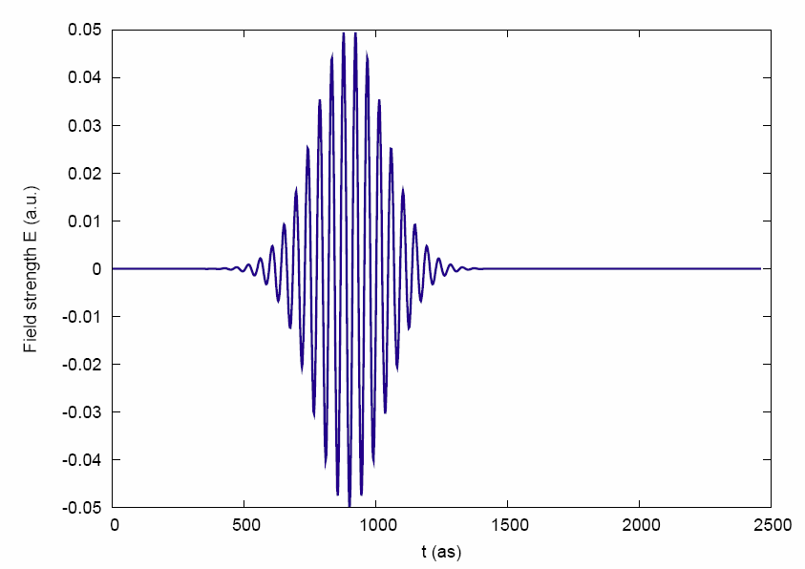

Two-electron wave packet
Interaction with a 225as 92eV XUV pulse:
double ionization
single ionization
single ionization
Laser field
After pulse: extract experimental observables

Slide 24
Experimental observables
Single ionization:
Double ionization:
Neglect electron-electron interaction in final state
◻ propagate to large (asymptotic) distances
Derived quantities:
Single and double ionization yields
(Joint) energy spectra
Angular distributions
Recoil ion momentum

Slide 25

FELs: Two-photon double ionization (TPDI)
Large photon energy (> 54.4 eV):
Sequential (two-step) process
Electron-electron interaction not necessary
◻ uncorrelated emission ◻ not exciting
Smaller photon energy:
Electrons need to share photon energy
nonsequential (direct) process
Electron-electron interaction essential
◻ strong correlation!
Hot Topic: total cross section?

Slide 26
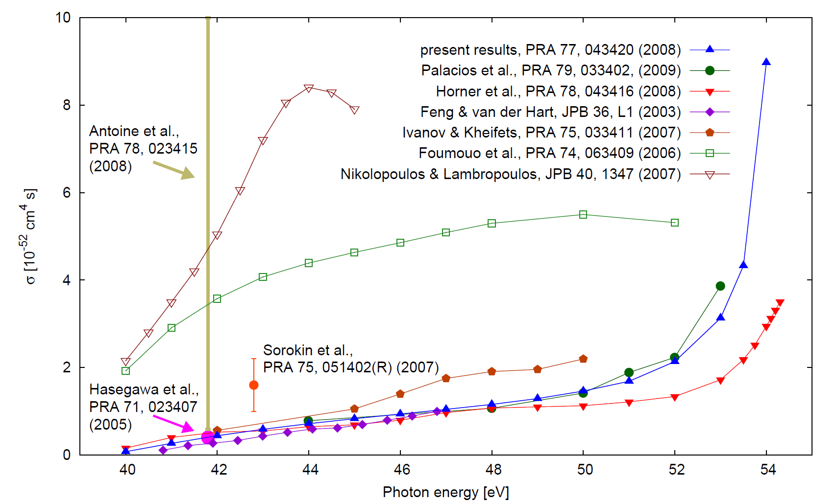
Comparison of Theoretical and Available Experimental Results -Total X-Sect
Considerable discrepancies!
Rise at sequential threshold
Extensive convergence tests:
angular momenta, radial grid, pulse duration (up to 20 fs),
time after pulse (propagate electrons to asymptotic region)
◻ error below 1%

Slide 27
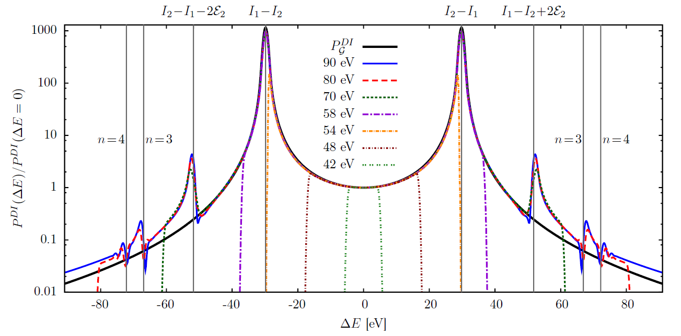
Photon energy dependence
Dramatic rise close to sequential threshold:
Virtual sequential process (Horner et al, Phys. Rev. A 76, 030701(R))
Angular correlations: back-to-back emission always dominant
(as for sequential regime between peaks)

Slide 28
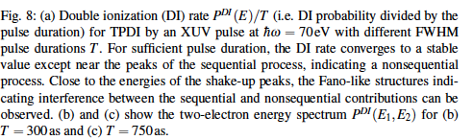
Time Dependence of Pulse

Slide 29
The Important Questions
Is the definition of T_eff correct and has it been done uniformly in existing calculations?
What is the effect of the shape and length of the laser pulse on observables?
How long is it necesssary to propagate to extract physically correct quantities? – Reflections
Is the projection onto products of Coulomb waves correct? If not, why and can one do better. This is a basic question concerning electron correlation in the final state.
What is the effect of various parameters such as angular momentum on physical observables.

Slide 30
Conclusion
Definition of T_eff is correct for Non-Sequential DI process
Total X-sections can be extracted properly using Coulomb projection - At long times and large distances the wavepacket consists of a superposition of stationary states with the electrons WELL SEPARATED
Pulse shape affects resolution
Total X-section not very sensitive to angular momentum included

Slide 31
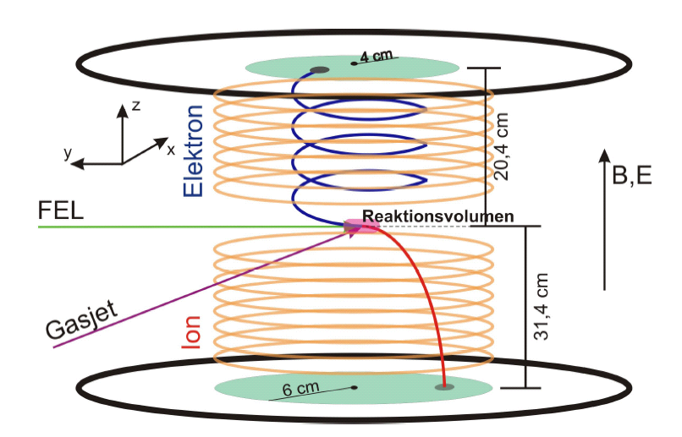
Nonsequential TPDI: Recoil ion momentum spectroscopy
Absolute calibration difficult in experiment ◻ compare distributions
Reaction microscope:
measure doubly charged ions in nonsequential TPDI
(collaboration with R. Moshammer et al.)

Slide 32
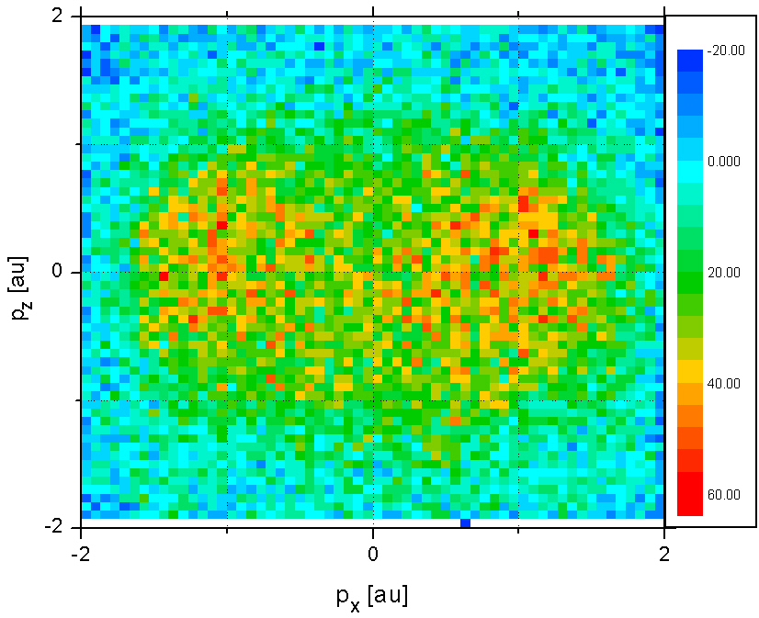
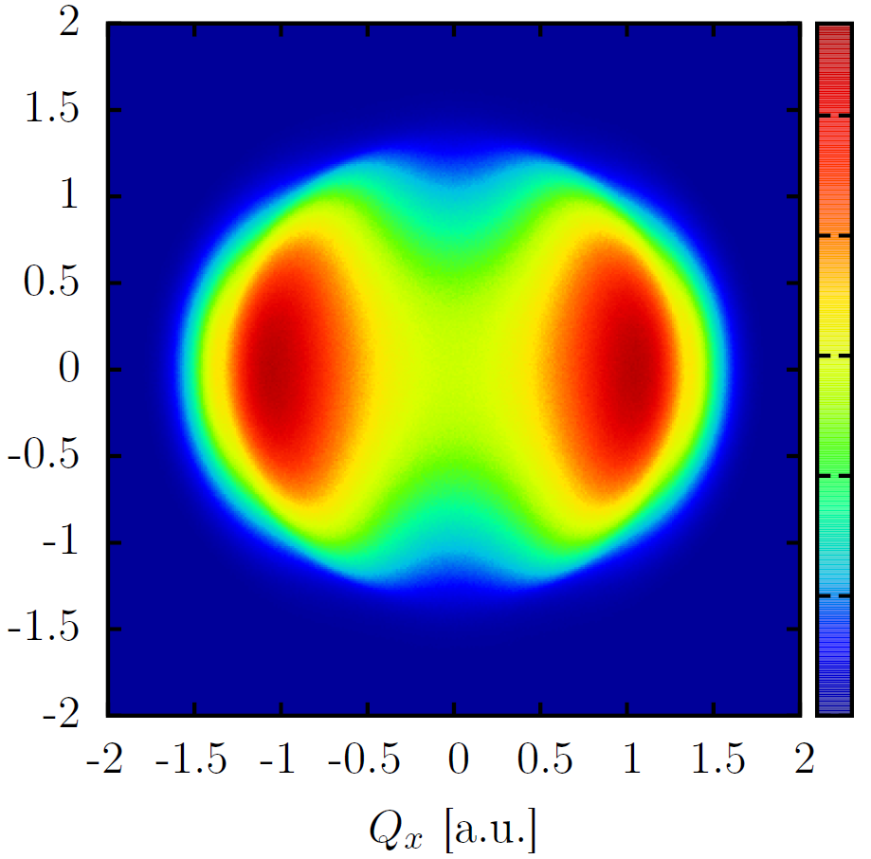
Nonsequential TPDI: Recoil ion momentum spectroscopy
Photon energy: 52 eV
FLASH
Simulation

Slide 33
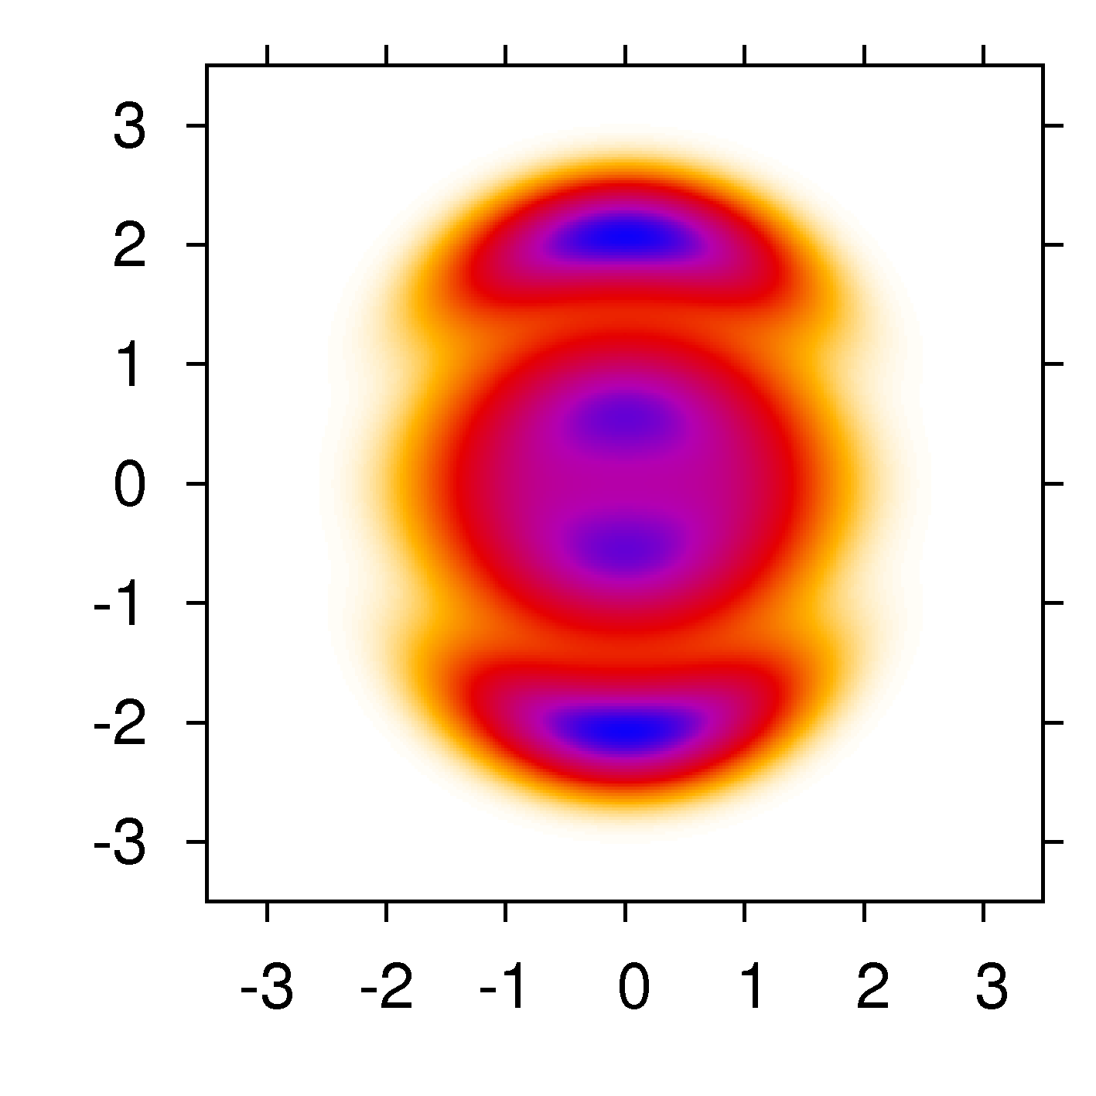
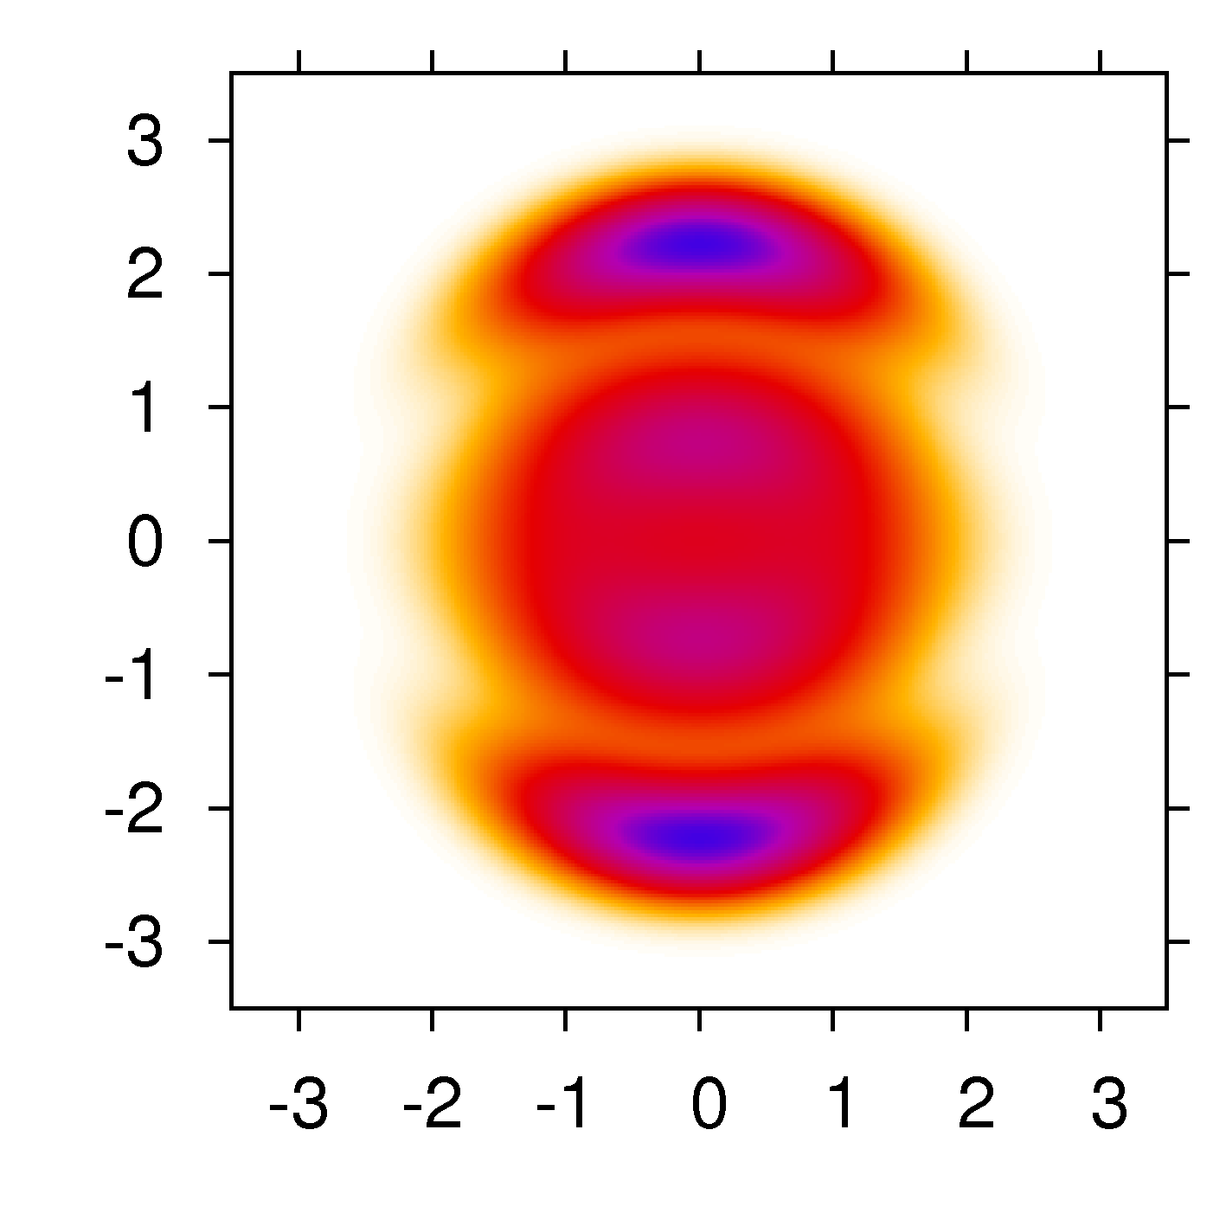
Nuclear recoil distributions
Nuclear recoil:
T = 150 as
Angular distribution: product of dipoles
Actual distribution
 Small effect

Slide 34
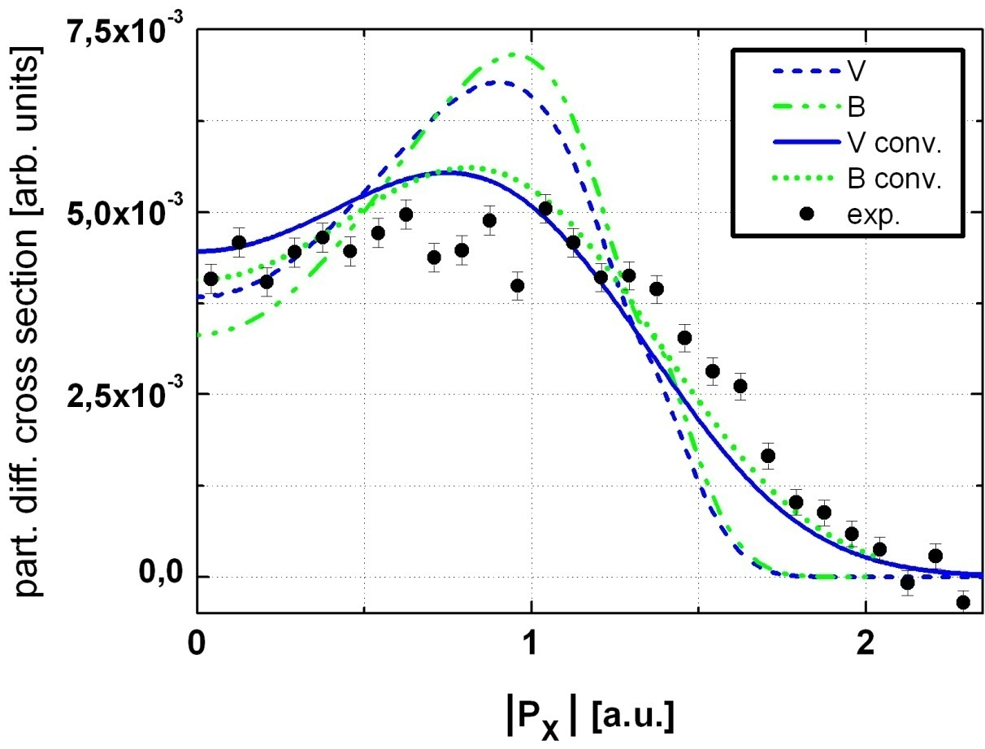
Nonsequential TPDI: Recoil ion momentum spectroscopy
Integrated distribution for better count rates:
◻ Good agreement with experiment (after convolution)
◻ Almost perfect agreement with Berkeley simulations (McCurdy et al.)
◻ Correlated electron dynamics visible in recoil momentum
Experimental challenges:
Low count rates
Background signal
Space charge
FEL shot-to-shot variations

Slide 35
Neutron Scattering: Kicking the Nucleus
Spallation neutron sources (e.g. SNS, Oak Ridge):
  high neutron flux (~5x10¹⁶ neutrons/s)
  neutron-atom collisions?
Neutron-atom scattering (at tens of keV)
  Negligible neutron-electron interaction
  Short-range (strong force) neutron-nucleus interaction ◻ elastic scattering
  Time scale neutron-nucleus scattering: < as
  Time scale electron-nucleus interactions (in helium): ~30 as
  “Kick” on nucleus (sudden approximation)
  J. Berakdar, J. Phys. B 35, L31 (2002)
Why helium?
  Simplest many-electron atom
  Rich correlation effects

Slide 36
Neutron impact ionization
Sudden approximation
  Frame of reference: scattered nucleus
  Momentum boost on electrons
Momentum boost operator:
Two-electron Hamiltonian not separable
Solve numerically ◻ use discretization schemes
  Angular: Close-coupling
  Radial: Finite element discrete variable representation (FEDVR)
Unknown boundary conditions for (double) continuum states
◻ circumvent with exterior complex scaling (ECS)
A. Palacios et al., Phys. Rev. A 76, 043420 (2007)
◻
Many-body operator!

Slide 37
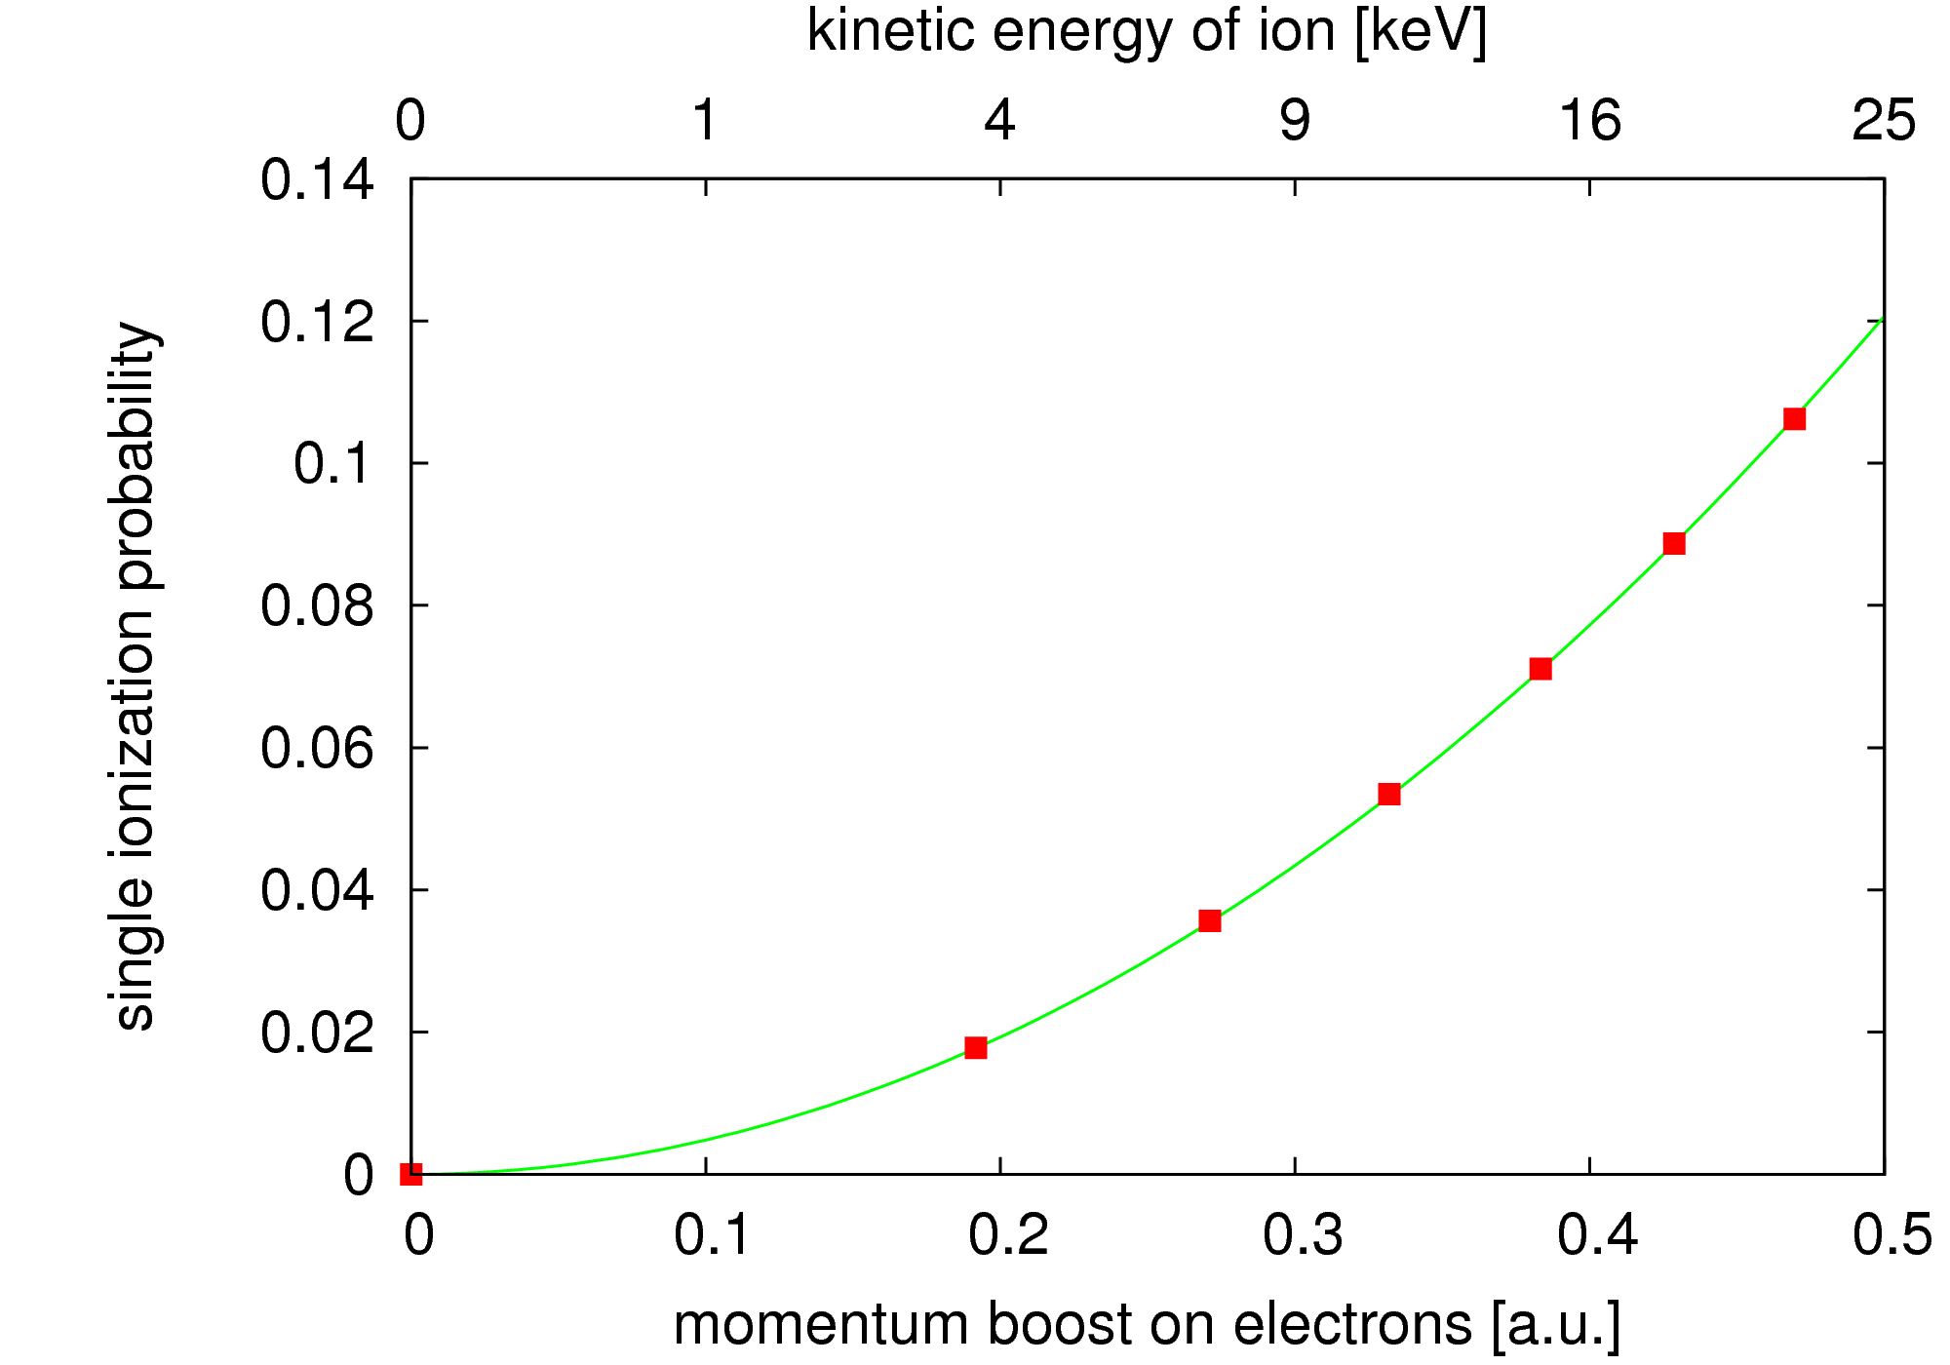
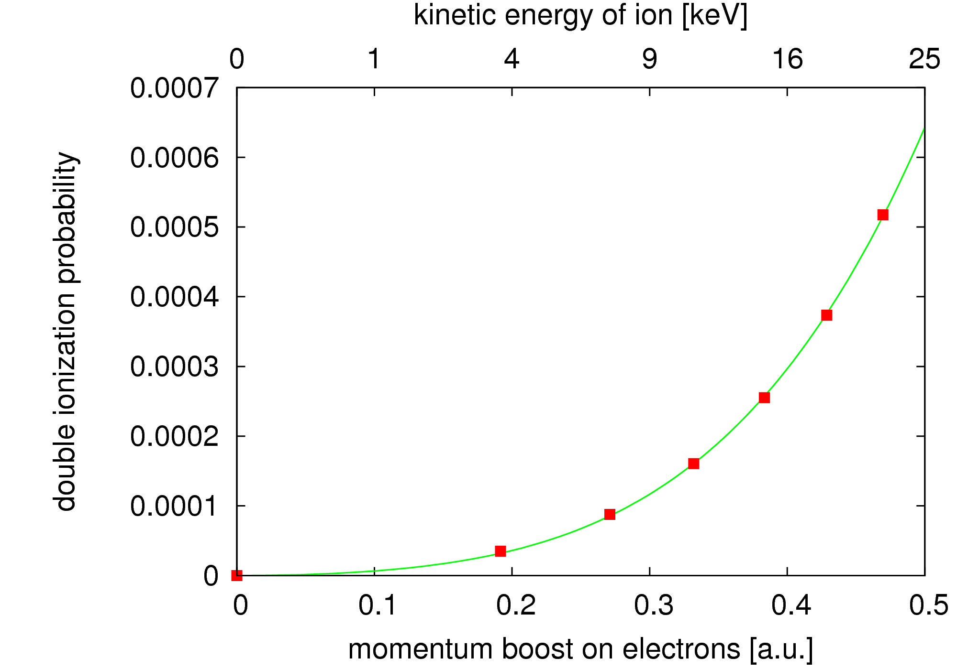
Total ionization yields
Single ionization
Double ionization
4th order polynomial
Weak neutron kicks:
Many-body part important in DI!

Slide 38
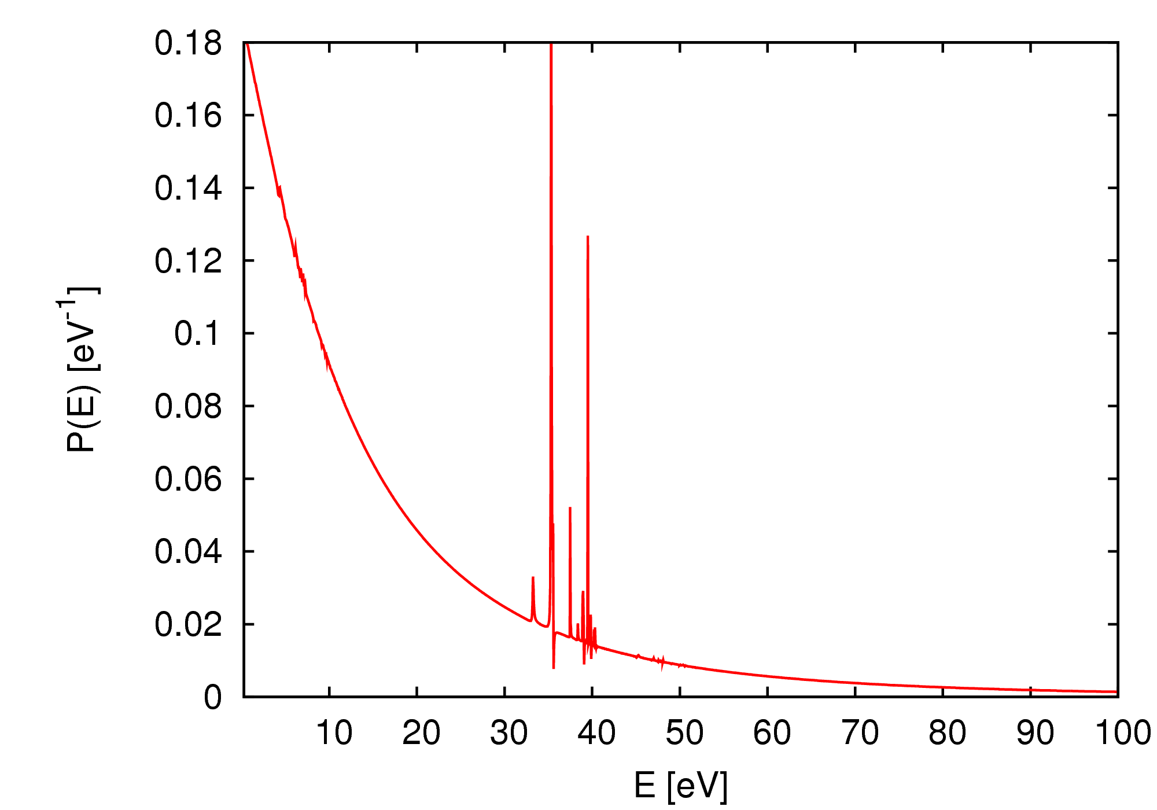
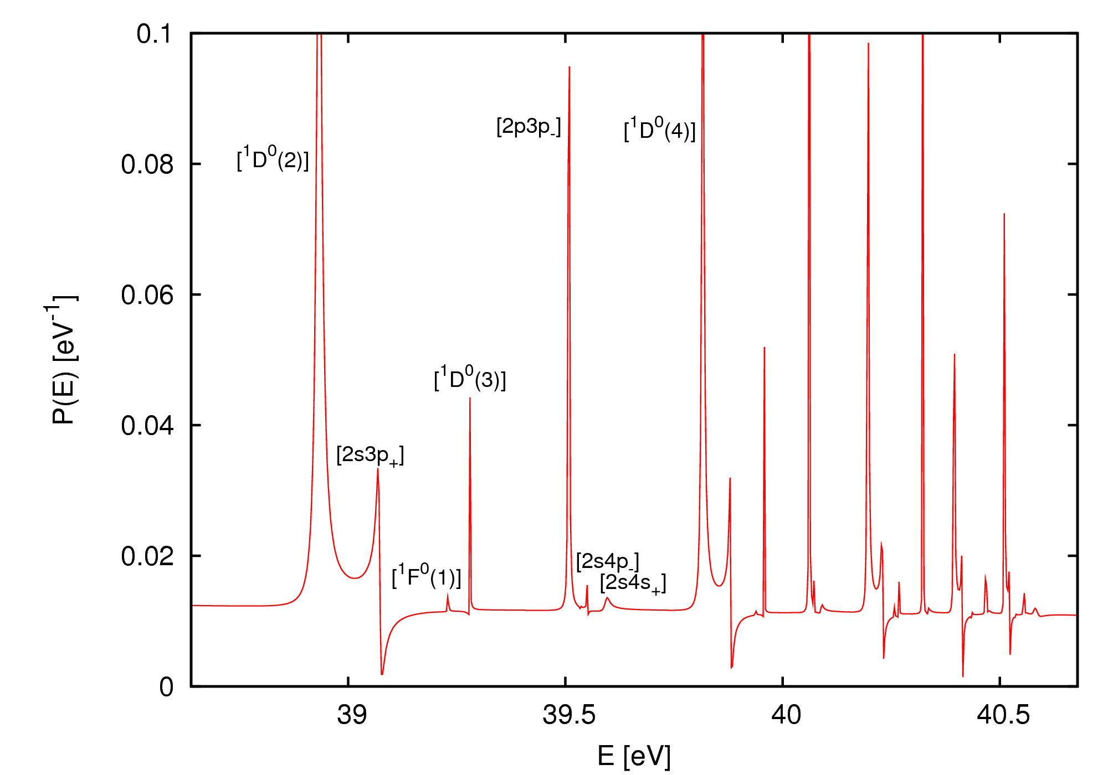
Electron spectra – doubly excited states
Boost: 0.5 au ~ 25 keV
Broad energy distribution
Many doubly excited states accessible

Slide 39
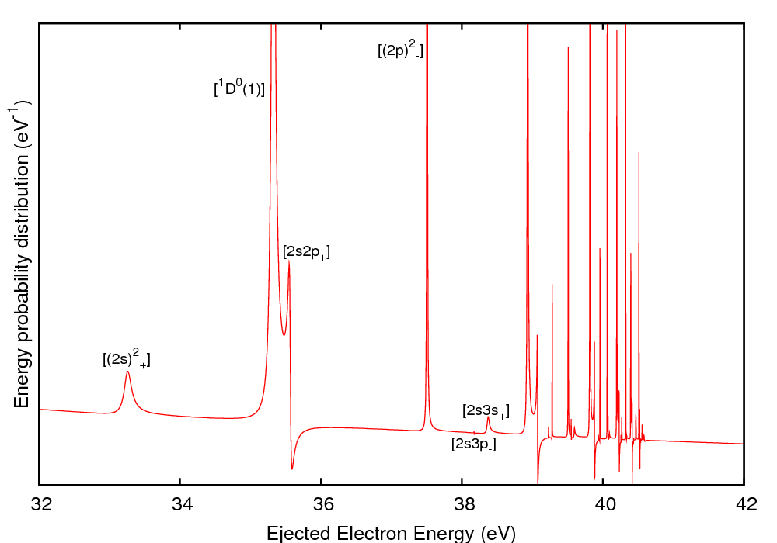
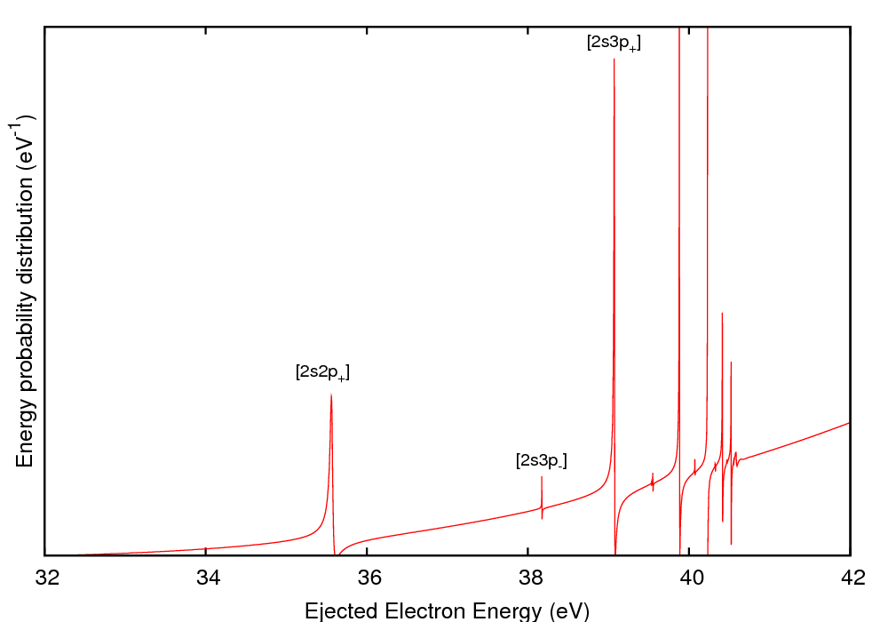
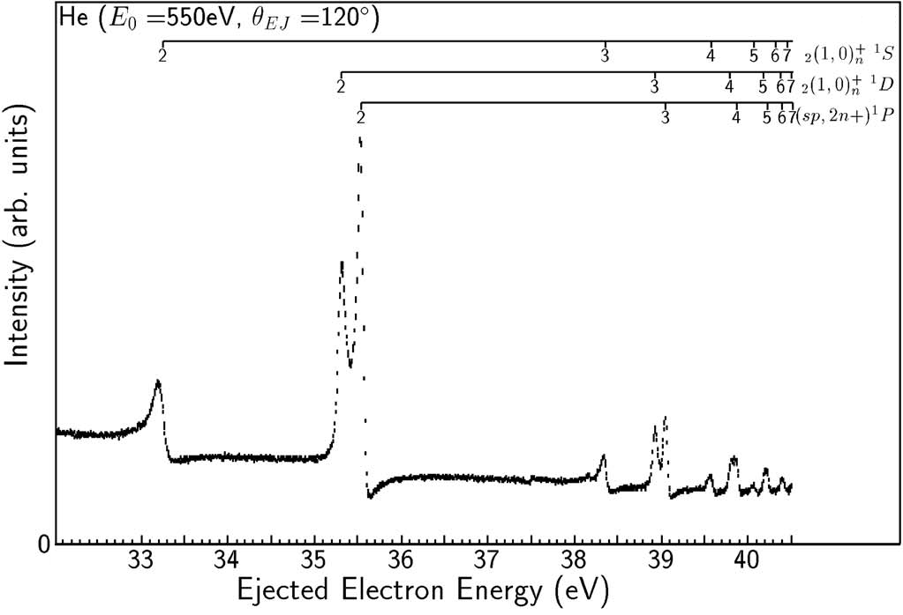
Electron spectra – doubly excited states
a)
b)
c)
Neutron impact ionization
One-photon ionization
Electron impact ionization
Selection rule:
B. A. de Harak et al., Phys. Rev. A 74, 032714 (2006)

Slide 40
Summary & Outlook
Neutron-nucleus scattering: true many-body transition
Basic experiment: ratio SI/DI
Access to doubly excited states not seen / suppressed in
photon or electron impact
Future directions:
  angular distributions
  inelastic neutron-nucleus scattering processes (breakup)
  more-electron atoms – molecules
  find experimentalists…

Slide 41

Quantum Interference Effects in
Major Findings
Perpendicular ionization about factor of three larger than parallel polarization at 50eV photon energy
When energy gets large enough, effect vanishes
Double slit-like interference patterns appear in perpendicular polarization - wave packets interference
At low energy “non-classical” behavior seen in diffraction angles
At higher energies even second order effects seen but again angle not in ageement with classical result
Interference path vs R Critical Factor

Slide 42
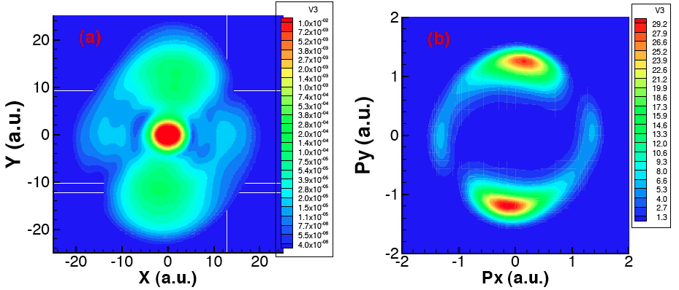
Quantum Interference Effects in
Final Momentum Distribution
Final Probability Density
Radiation at 45 Degrees to R (x-axis)
Light polarized in xy plane
50ev
500as

Slide 43
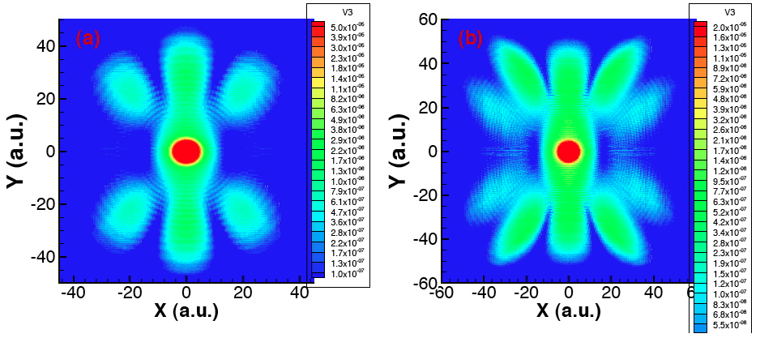
Quantum Interference Effects in
Photon energy =350eV
Photon energy =630eV
Classical double slit distribution
Non classical distribution
Final Probability density for incident radiation at 90 degrees to R

Slide 44
Essential Collaborators
Johannes Feist, Stefan Nagele, Renate Pazourek, Andreas Kaltenback and Joachim Burgdoerfer - Technical University of Vienna
Klaus Bartschat, Xiaoxu Guan and Oleg Zatsarinny - Drake University
Lee Collins - Los Alamos National Laboratory
Suxing Hu - Rochester Laser Energetics Laboratory
Cliff Noble - Daresbury Laboratory
NSF XSEDE and computing facilities TACC (Ranger/Stampede), NICS(Kraken), SDSC(Gordon) and LANL Institutional Computing(Coyote)

Slide 45













Acknowledgements & collaborators
J. Burgdörfer
E. Persson
International Max Planck Research School on Advanced Photon Science
S. Nagele
R. Pazourek
B. I. Schneider
K. Ishikawa
L. A. Collins
grant TG-PHY090031
FWF Austria, SFB-16

Slide 46
Essential Collaborators
Johannes Feist, Stefan Nagele, Renate Pazourek, Andreas Kaltenback and Joachim Burgdoerfer - Technical University of Vienna
Klaus Bartschat, Xiaoxu Guan and Oleg Zatsarinny - Drake University
Lee Collins - Los Alamos National Laboratory
Suxing Hu - Rochester Laser Energetics Laboratory
Cliff Noble - Daresbury Laboratory
NSF XSEDE Program and computing facilities at the TACC (Ranger & Stampede), NICS (Kraken ), SDSC (Gordon) and Los Alamos Institutional Computing (Coyote)

