Slide 1
GPU-Focused Image Compression Techniques
Pavel Krajcevski
The University of North Carolina at Chapel Hill
10/19/2015
Notes:
GPU: Graphics Processing Unit
“Give an introduction”

Slide 2
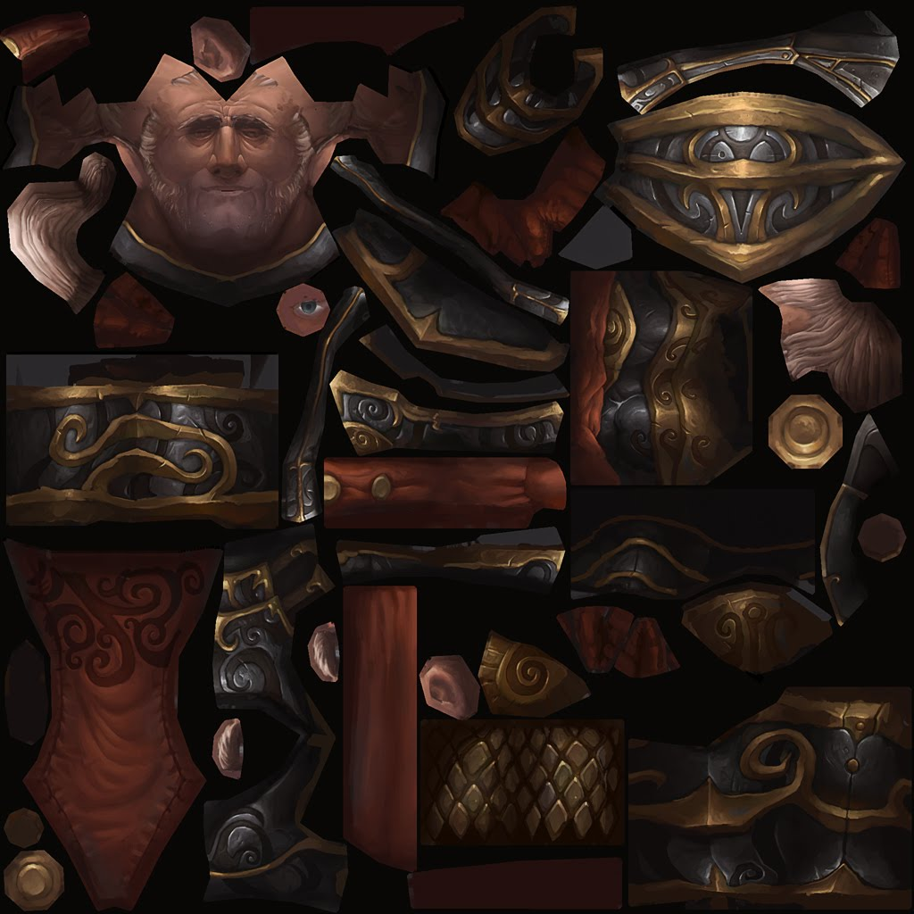
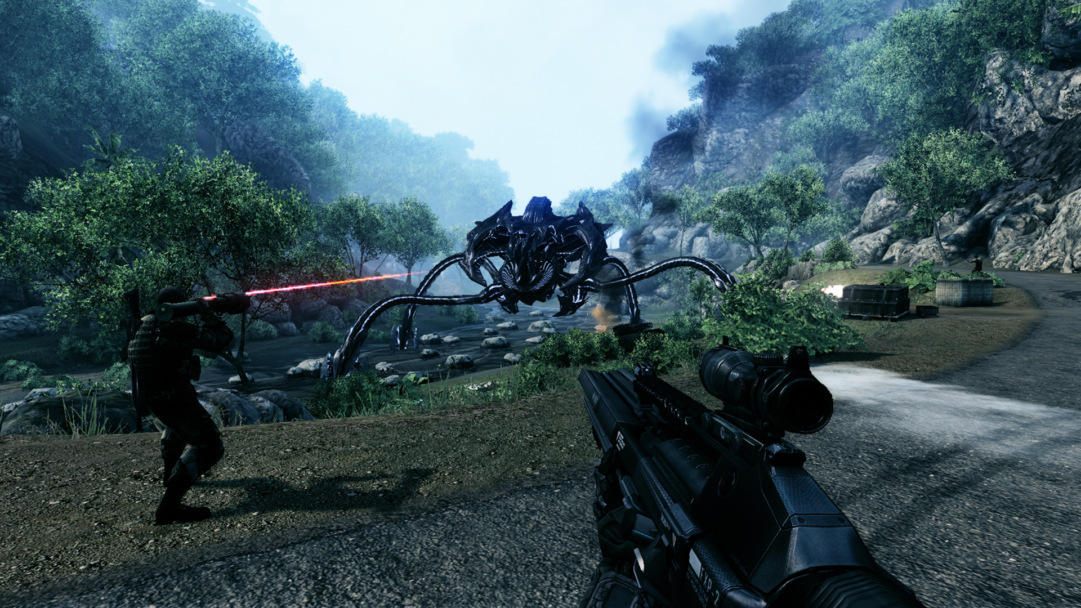

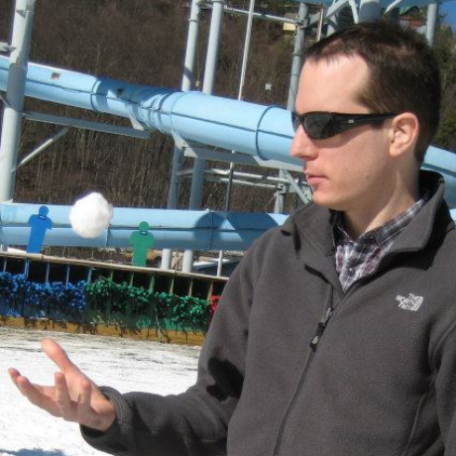



Introduction
Images are everywhere.
From 3D...
… to 2D

Slide 3

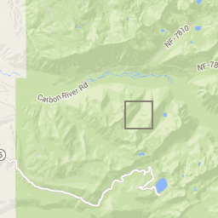
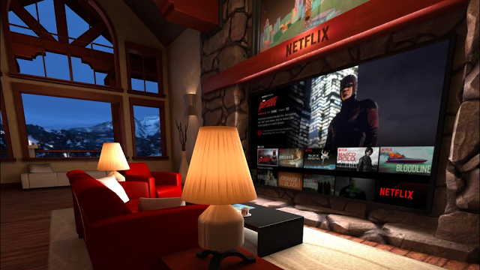
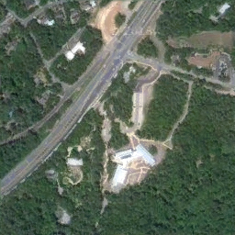
Introduction
Why GPUs?
Virtually every user-facing application uses images.
Graphics algorithms require fast access to image data.
GIS Applications
Virtual Streaming

Slide 4
Introduction
Web Server
CPU RAM
GPU RAM
Disk
Web Browser
Interactive Graphics App
Native UI
The more data you have, the longer this takes
Image data needs to travel.

Slide 5
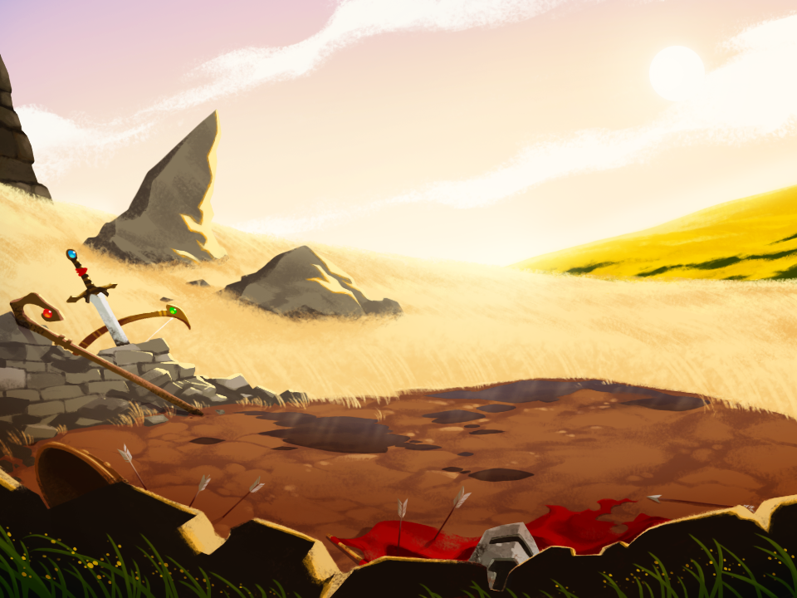
Introduction
Solution: compress everything
PNG
706KB
Original
1.98MB
JPEG
124KB
960 x 720

Slide 6
Introduction
Most pipelines looks like this:
PNG
706KB
CODEC
Original
1.98MB
JPEG
124KB
960 x 720
Storage
CPU RAM
Notes:
CPU: Central Processing Unit

Slide 7
Introduction
However, we want to use special purpose hardware!
CODEC?
CODEC
PNG
706KB
CODEC
???
?? KB
Original
1.98MB
JPEG
124KB
GPU RAM
960 x 720
Storage
CPU RAM

Slide 8
Introduction
OK, so why not send JPEGs to the GPU?

Slide 9
Image Compression:
Traditional vs GPU

Slide 10
Overview: Image Compression
Lots of image compression formats.
Let’s focus on two:
PNG
706KB
JPEG
124KB

Slide 11
Overview: PNG
Based on Huffman Encoding: assign bit pattern to each color based on frequency
11
01
001
0000
0001
So, these pixels
Become these bits:
010101110010000110011100010111011100111110000

Slide 12

Overview: PNG
Advantages:
Lossless
Great for images with few colors (icons)
Uncompressed: 391 KB
PNG: 13.5 KB
544 x 184
Notes:
Lossless vs lossy: two options, what they mean

Slide 13
Overview: JPEG
Compression
Transform (lossless): Convert pixels from one coordinate space to another (DCT, DWT, etc…)
Quantization (lossy): Change accuracy of certain “unimportant” transform coefficients
Encoding (lossless): Save transform coefficients as bits depending on their frequency (Huffman)
Decompression

Slide 14
Overview: JPEG
Compression
Transform (lossless): Convert pixels from one coordinate space to another (DCT, DWT, etc…)
Quantization (lossy): Change accuracy of certain “unimportant” transform coefficients
Encoding (lossless): Save transform coefficients as bits depending on their frequency. (Huffman)
Degree of quantization determines lossiness:
Original value: 4273
Quantized: 4273 / 16 = 267
Reconstructed: 267 * 16 = 4272
Decompression
Quantized: 4273 / 160 = 27
Reconstructed: 27 * 160 = 4320

Slide 15
Overview: JPEG
Compression
Transform (lossless): Convert pixels from one coordinate space to another (DCT, DWT, etc…)
Quantization (lossy): Change accuracy of certain “unimportant” transform coefficients
Encoding (lossless): Save transform coefficients as bits depending on their frequency. (Huffman)
However, similar values (closer to zero) are easier to represent (contain less information) than dissimilar values.
High quantization means high compression
Decompression

Slide 16
Overview: JPEG
Advantages:
Great for images that can handle loss (natural images, consumed by HVS)
Uncompressed: 4.3 MB
PNG: 2.3 MB
JPEG: 211 KB
1504 x 1000 (JPEG)

Slide 17
Overview: Traditional Compression
Main idea behind traditional image compression techniques:
Groups of similar pixels receive fewer bits
This is the problem for GPUs

Slide 18
Overview: GPUs need data fast
Consider the following two PNG scenarios:
01010111001000011001110001
The pixel at index six starts at two separate locations for each stream!
110011100010101010111001
In order to access the pixel at index six, we must read the first five!
Notes:
GPUs are parallel
They read all pixels at once -- not in sequence

Slide 19
Overview: GPUs need data fast
To make it uniform, we’d need to pad the bitstreams to the largest pattern
XX01XX01XX01XX11X0010000XX11X001XX110001
XX11X001XX110001XX01XX01XX01XX01XX11X001
Now we know where each pixel is in memory!
But this results in no compression!

Slide 20
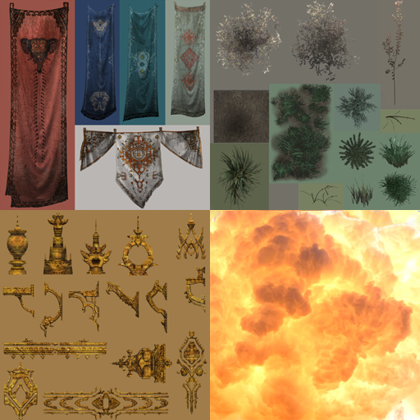
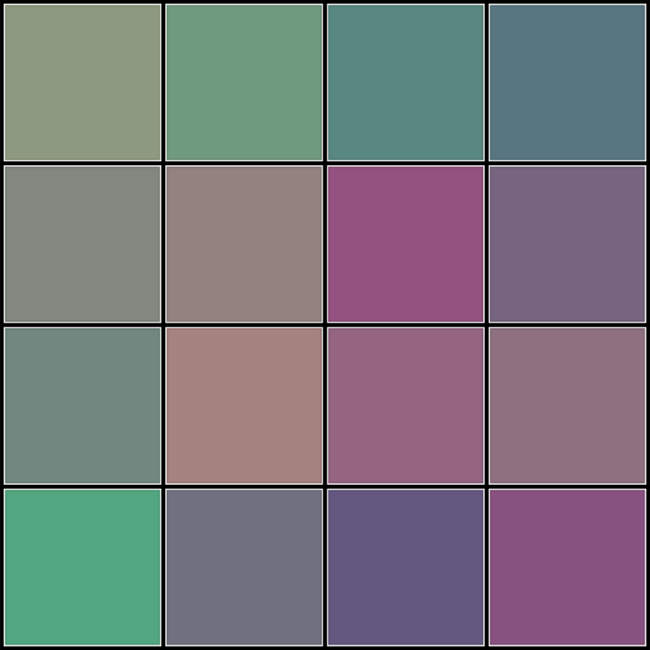
Overview: GPU Image Compression
Represent groups of pixels in a fixed number of bits.
1100111000101…
64 bits?
32 bits?
Notes:
This is a block

Slide 21
Overview: GPU Image Compression
What we get: Random access to pixels Fast decompression | What we give up: Variable bit-rate compression Lossless compression Simple compression routine
Notes:
Lossy in general case -- doesn’t mean lossy always

Slide 22
GPU Image Compression:
The DXT Algorithm

Slide 23
DXT Compression
Consider each pixel as a point in RGB space
8e9a80 | 709a80 | 588880 | 587680
828880 | 948280 | 945280 | 766480
708880 | a68280 | 946480 | 8e7080
52a680 | 707080 | 645880 | 885280
8e9a80 | 709a80 | 588880 | 587680
828880 | 948280 | 945280 | 766480
708880 | a68280 | 946480 | 8e7080
52a680 | 707080 | 645880 | 885280
B
R
G
Notes:
Don’t move quickly

Slide 24
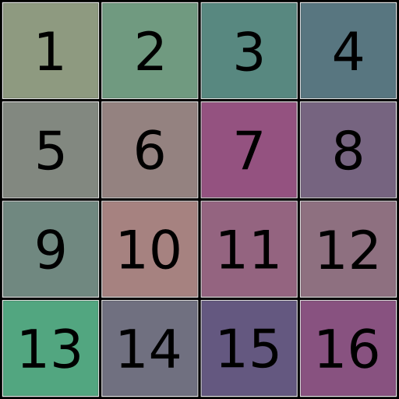
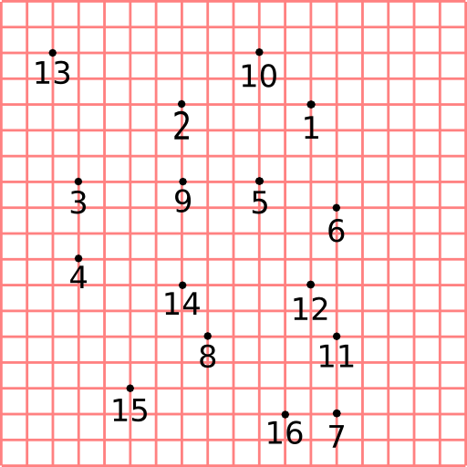
DXT Compression
For simplicity we will only display 2D RG space
G
R

Slide 25
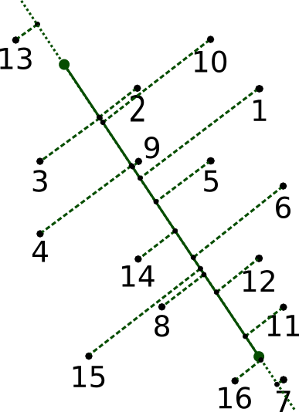
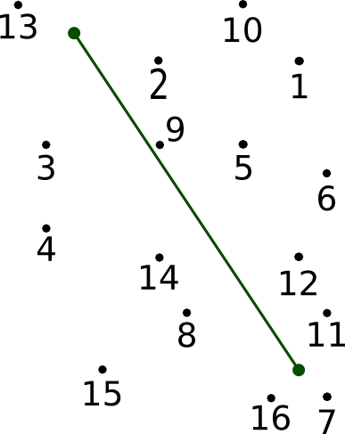
DXT Compression
Approximate each point by projecting it onto a line.
G
R
Notes:
The projection is the lossy part

Slide 26
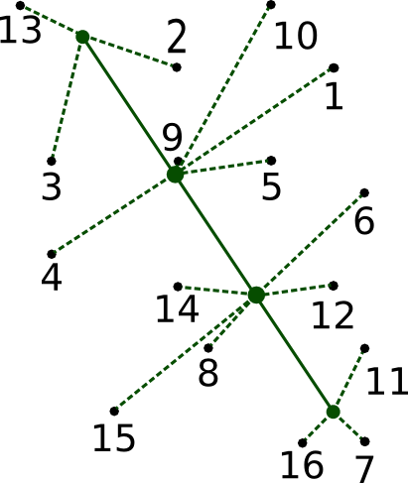
DXT Compression
To save bits, approximate each projection to a predetermined interpolation point
G
G
R
R
Notes:
2 bits = 4 possible values

Slide 27

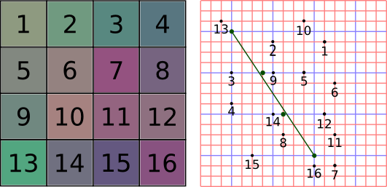
DXT Compression
Hence, we compress a 4x4 block of pixels down to 64 bits:
Endpoint 1
Endpoint 2
5 | 6 | 5 | 5 | 6 | 5
2 | 2 | 2 | 2 | 2 | 2 | 2 | 2 | 2 | 2 | 2 | 2 | 2 | 2 | 2 | 2
Index Values

Slide 28
Difficult optimization problem!
Choosing proper endpoints is an NP-Hard optimization problem!
But we can approximate:
Assign per-pixel interpolation values first
Find best endpoints that emit approximated interpolation values
[Brown ‘06]

Slide 29
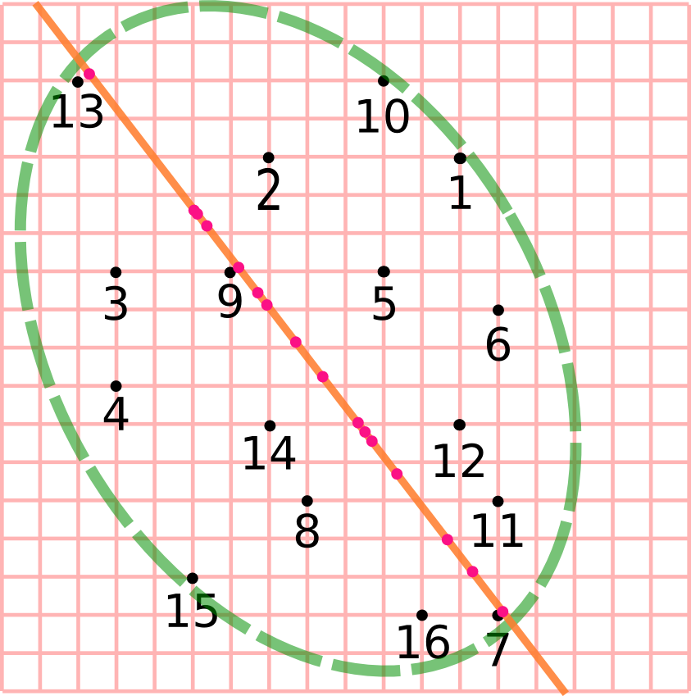
DXT Compression: Cluster Fit
Step one: Project data along principal axis

Slide 30
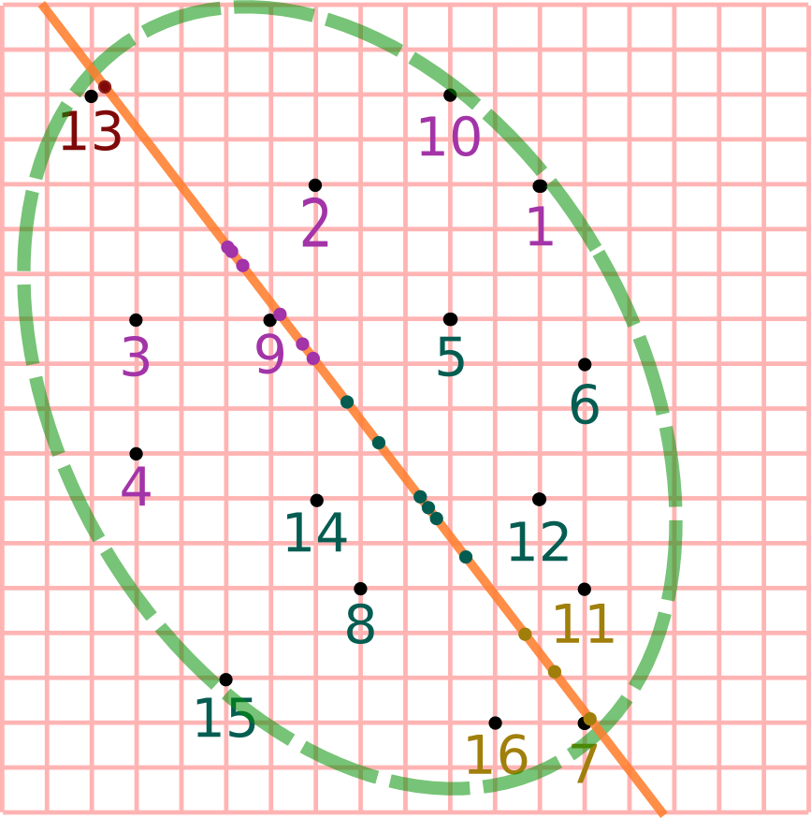
DXT Compression: Cluster Fit
Step two: Compute clustering along this axis
Notes:
centroid not midpoint

Slide 31
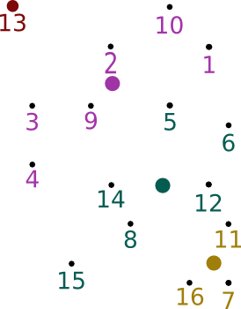
DXT Compression: Cluster Fit
Step three: Assign indices to clusters
00
01
10
11
G
R

Slide 32
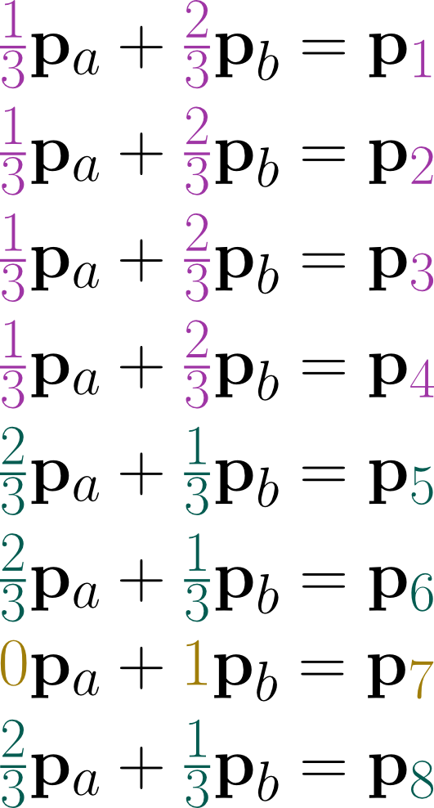
DXT Compression: Cluster Fit
Step four: Solve overconstrained system for endpoints
00
01
10
11
G
etc...
R

Slide 33
GPU Image Compression:
Advanced Techniques

Slide 34
Advanced Techniques
DXT Offers: 6-to-1 compression ratio, worse quality than JPEG.
Can we do better?

Slide 35
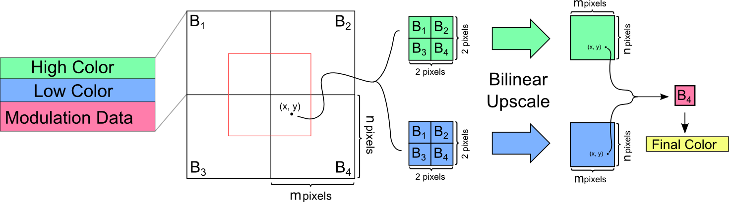
PVRTC: Interpolate Endpoints
Interpolate endpoints between blocks to get better per-pixel endpoints
[Fenney ‘03]

Slide 36
PVRTC: Intensity Dilation
Problem: Find per-block endpoints that will be interpolated
Cluster fit leads to blocky artifacts and doesn’t work!
Idea: Assume endpoints represent high and low intensity pixel values
[Krajcevski and Manocha ‘14]

Slide 37
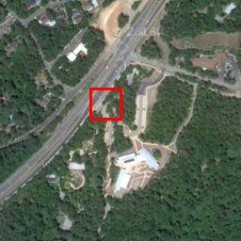
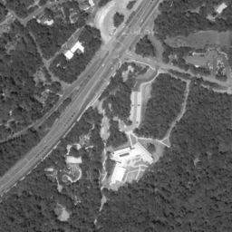
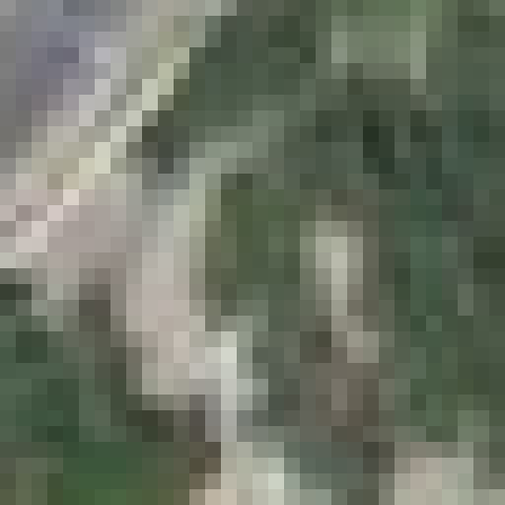
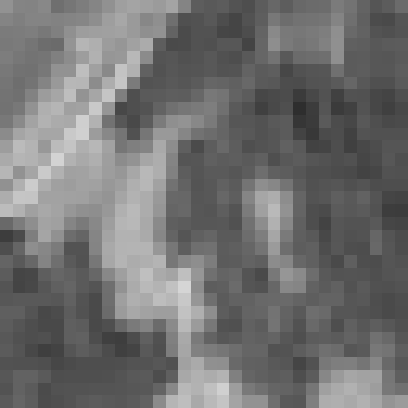
PVRTC: Intensity Dilation
Method: Average locally maximal and minimal intensity pixels that affect a block
Algorithm:
1. Convert image to grayscale
2. Identify extrema
3. Split extrema pixels
4. Dilate extrema
5. Fill holes
6. Downscale
Original
Intensity

Slide 38
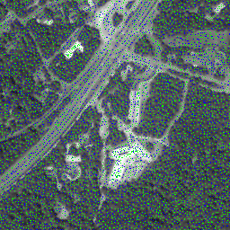
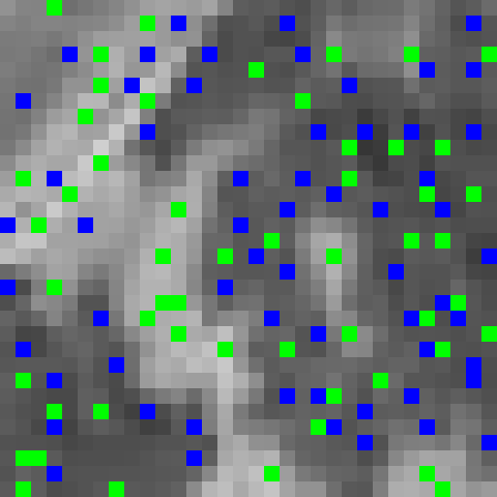
PVRTC: Intensity Dilation
Method: Average locally maximal and minimal intensity pixels that affect a block
Algorithm:
1. Convert image to grayscale
2. Identify extrema
3. Split extrema pixels
4. Dilate extrema
5. Fill holes
6. Downscale
Intensity
Identified

Slide 39
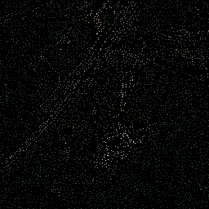
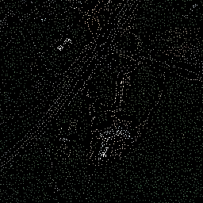
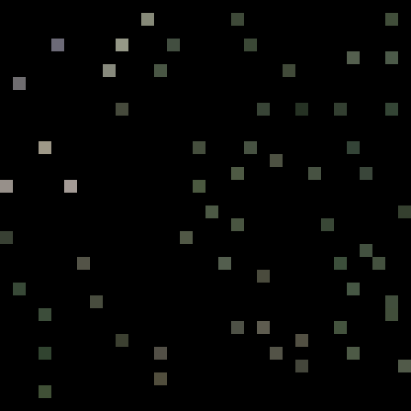

PVRTC: Intensity Dilation
Method: Average locally maximal and minimal intensity pixels that affect a block
Algorithm:
1. Convert image to grayscale
2. Identify extrema
3. Split extrema pixels
4. Dilate extrema
5. Fill holes
6. Downscale
Identified
Low Pixels
High Pixels
Notes:
local maxima/minima

Slide 40
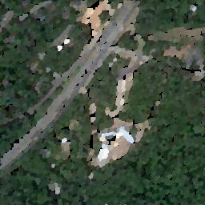
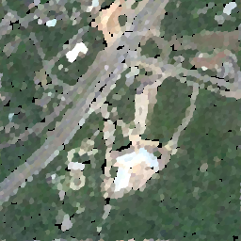
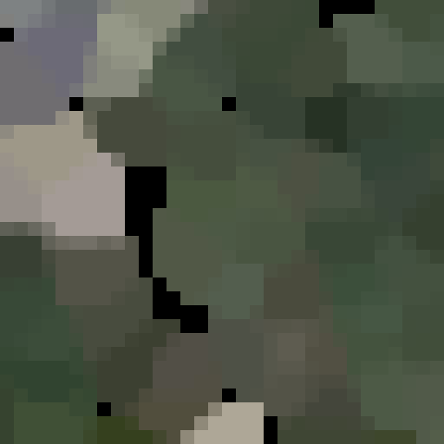

PVRTC: Intensity Dilation
Method: Average locally maximal and minimal intensity pixels that affect a block
Algorithm:
1. Convert image to grayscale
2. Identify extrema
3. Split extrema pixels
4. Dilate extrema
5. Fill holes
6. Downscale
Identified
Low Dilated
High Dilated
Notes:
Predetermined dilation
explains gaps

Slide 41
PVRTC: Intensity Dilation
Method: Average locally maximal and minimal intensity pixels that affect a block
Algorithm:
1. Convert image to grayscale
2. Identify extrema
3. Split extrema pixels
4. Dilate extrema
5. Fill holes
6. Downscale
Identified
Low Dilated
High Dilated

Slide 42


PVRTC: Intensity Dilation
Method: Average locally maximal and minimal intensity pixels that affect a block
Algorithm:
1. Convert image to grayscale
2. Identify extrema
3. Split extrema pixels
4. Dilate extrema
5. Fill holes
6. Downscale
Low Image
High Image

Slide 43
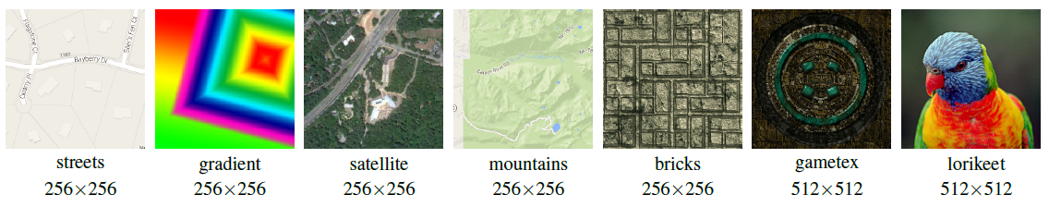
PVRTC: Results - Speed
 | streets | gradient | satellite | mountains | bricks | gametex | lorikeet
PVRTexTool (ms) | 63.74 | 65.11 | 64.92 | 66.63 | 65.45 | 264.68 | 263.14
FasTC (ms) | 17.76 | 20.30 | 20.93 | 21.77 | 21.91 | 97.25 | 97.39

Slide 44
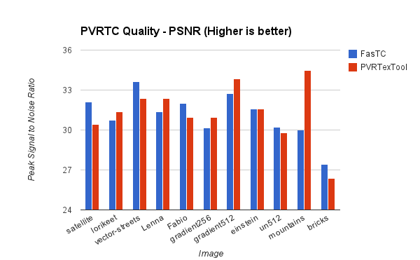
PVRTC: Results - Quality

Slide 45
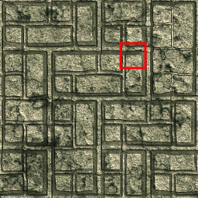
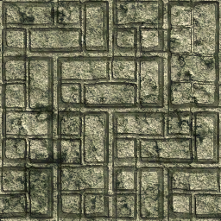
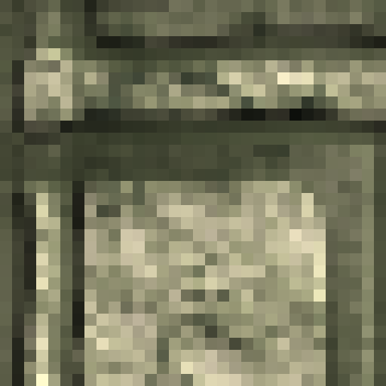
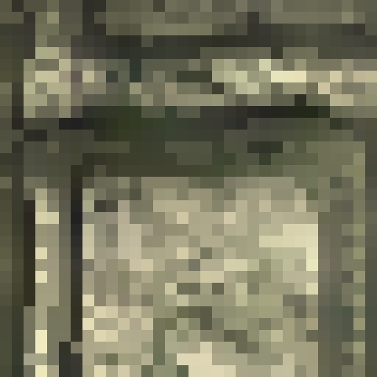
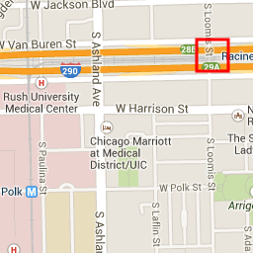
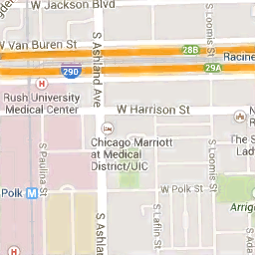


PVRTC: Results - Quality
Original
Compressed
Inset - Original
Inset - Compressed

Slide 46
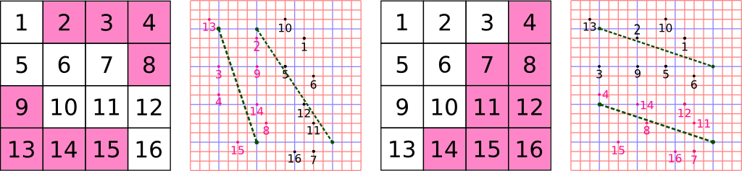
BPTC (aka BC7): Advanced DXT
Let’s split the blocks into partitions and use separate endpoints for each group.
G
G
R
R
[OpenGL ‘10]

Slide 47
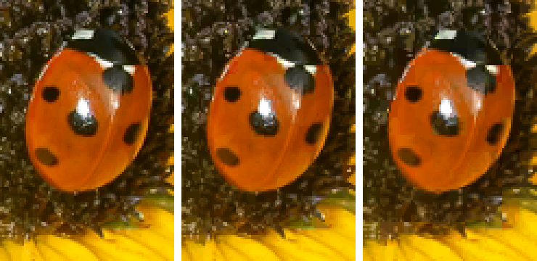
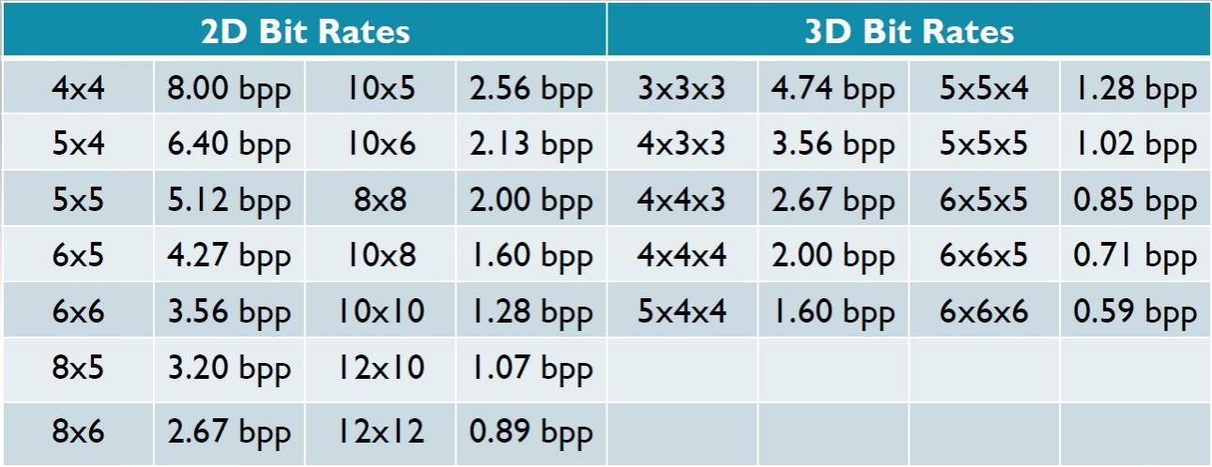
ASTC: Adaptive Block Sizes
Partitioning and different block sizes to vary the compressed size and quality
4x4 blocks
6x6 blocks
8x8 blocks
[Nystad et al. ‘12]

Slide 48
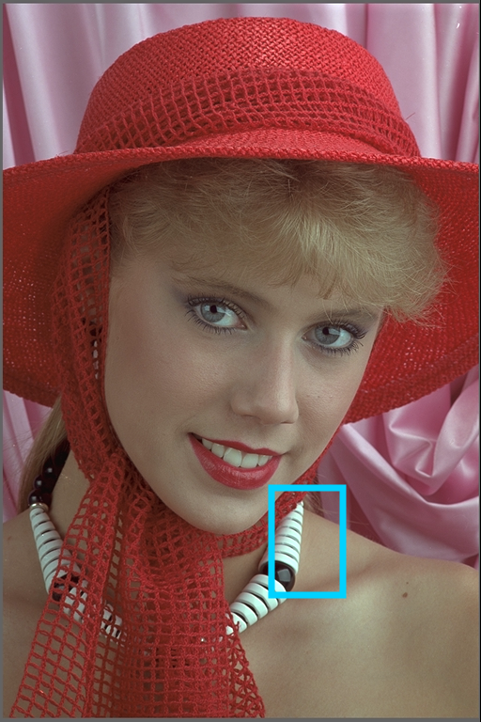


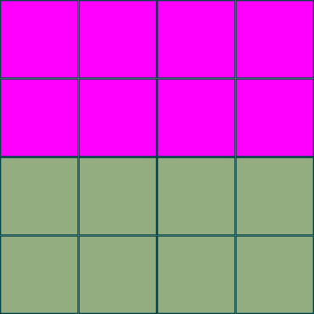

ASTC/BC7 Techniques
How do you select partitions?
Approximate compressed parameters [Krajcevski and Manocha ‘13]
Perform image segmentation and match local segmentation boundaries [Krajcevski and Manocha ‘14]

Slide 49
GPU Image Compression:
Interactive Applications

Slide 50
Coverage Masks
How do we determine:
What pixels to turn on?
How much to turn them on?

Slide 51
Coverage Masks
Standard way:
Turn on a pixel based on how much it’s covered:
Inside
Outside

Slide 52


Coverage Masks
OK, so how do you determine inside?

Slide 53

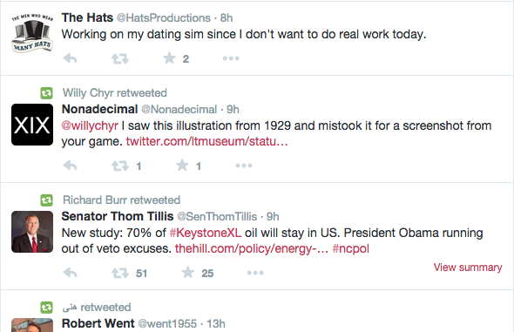
Coverage Masks
Small details like this are pretty common!

Slide 54
Coverage Masks
Traditional CPUs:
Go line by line and walk along edges
GPUs:
Do all pixels at once
Difficult to do without per-pixel edge information

Slide 55
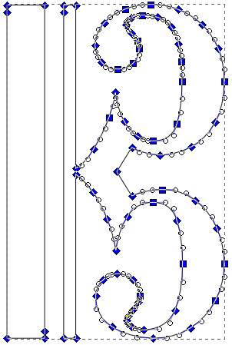


Coverage Masks
CPU
GPU
GPU is good at blending, shading…
CPU is good at determining path coverage...

Slide 56

Coverage Masks
Generate coverage texture with the CPU!
Fully opaque: (coverage == 255)
Fully transparent: (coverage == 0)
Only edges have intermediate
values.

Slide 57
Compressed Coverage Masks
Can we compress fast enough such that:
(Compression Time) + (Compressed Upload Time)
is less than
(Uncompressed Upload Time)

Slide 58
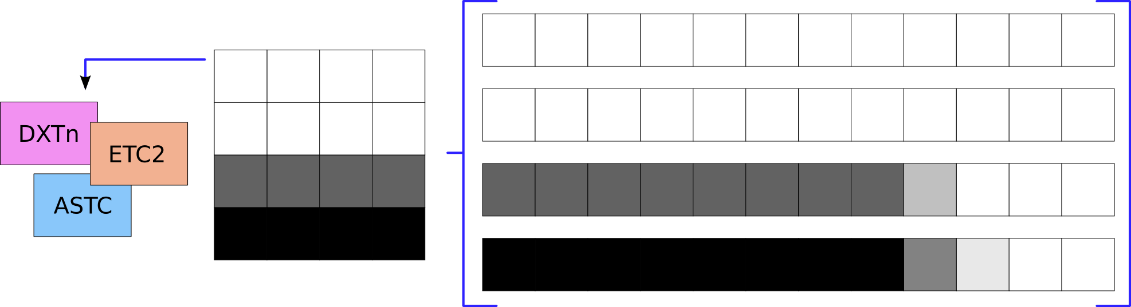
Compressed Coverage Masks
All black and all white blocks can be precomputed

Slide 59


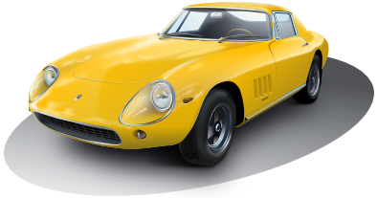


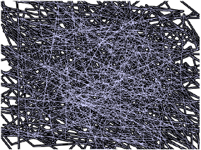
Results
We compare rendering speed of these images:
Tiger
Chalkboard
Car
Crown
Dragon
Polygon

Slide 60
Results: Rasterization Time
Uncompressed
Image: | Tiger | Chalkboard | Car | Crown | Dragon | Polygon
Mean: | 98 ms | 371 ms | 385 ms | 137 ms | 96 ms | 154 ms
Std Dev: | 3 ms | 5 ms | 2 ms | 15 ms | 7 ms | 5 ms
100 samples taken on 1st generation Moto X
Compressed (ETC2)
Image: | Tiger | Chalkboard | Car | Crown | Dragon | Polygon
Mean: | 83 ms | 350 ms | 386 ms | 111 ms | 101 ms | 137 ms
Std Dev: | 3 ms | 5 ms | 3 ms | 9 ms | 19 ms | 7 ms

Slide 61






Results: Quality
Uncompressed
Compressed

Slide 62
GPU Image Compression:
Conclusions

Slide 63
Conclusions
Images are everywhere
Compressing images is critical
Traditional CPU compression unavailable on GPUs
We’ve shown improved techniques for:
PVRTC - BPTC
Coverage Masks

Slide 64
Future Work
JPEG: 124 KB
BPTC
675KB
BPTC
675KB
Hard Disk Storage
BPTC
675KB
GPU Video RAM
BPTC
675KB
Streaming LOD
Network Storage

Slide 65
Future Work
???
150KB
BPTC
675KB
Hard Disk
Decompress
Streaming
LOD
GPU Video RAM
Network

Slide 66




Future Work
DXT
Original
Two low-res images using RGB565
One full-resolution lerp image using 2-bits per pixel

Slide 67
Future Work
Natural images can be compressed using JPEG-ish
Index image can be compressed using predictive coding with residual
[Wennersten ‘09]

Slide 68





Thank You
Sponsors:
Questions?

Slide 70


Introduction
Workflow looks like this:

