Slide 1

A Flexible Statistical Control Chart for Dispersed Count Data
Kimberly F. Sellers, Ph.D.
Department of Mathematics and Statistics
Georgetown University

Slide 2
Presentation Outline
Background distributions and properties
  Poisson distribution
  Alternative distributions
  Conway-Maxwell-Poisson distribution
Control chart for count data
Examples
Discussion

Slide 3
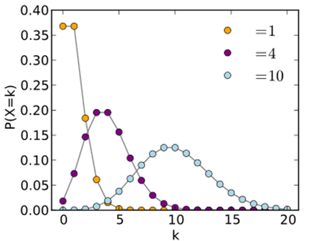




The Poisson Distribution
$Y\sim$Poisson($λ$), has probability function
$$P\left(Y=y ∣ λ\right)=\frac{e^{−λ}λ^{y}}{y!}, y=0,1,2,….$$
$λ=E\left(Y\right)=\text{Var}\left(Y\right)>0$
$$λ$$
$$λ$$
$$λ$$

Slide 4

Motivation: Poisson Distribution
$E\left(Y\right)=Var\left(Y\right)=λ$, i.e. $GOF=\frac{Var(Y)}{E(Y)}=1$
  Implies equidispersion assumption
  Assumption oftentimes does not hold with real data
  Implications affect numerous applications involving count data!
Regression analysis | Quality control
Risk analysis | Stochastic processes
Multivariate data analysis | Time series analysis

Slide 5
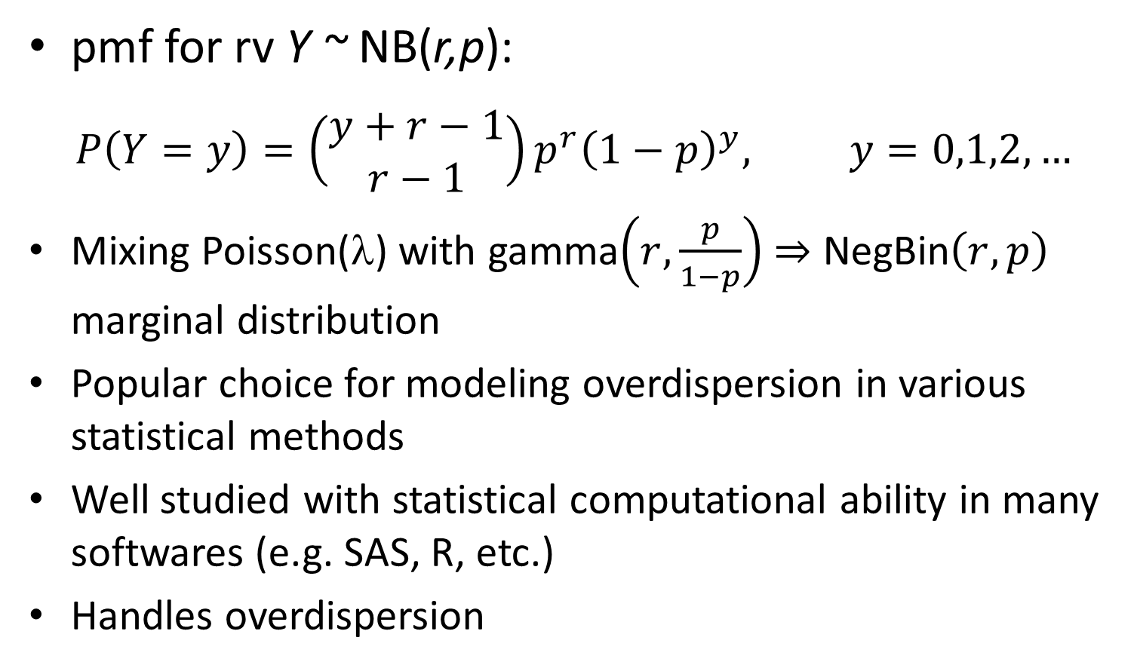
Alternative I:
Negative Binomial Distribution
pmf for rv Y ~ NB(r,p):
$$P\left(Y=y\right)=\left(\begin{matrix}y+r−1 \\ r−1\end{matrix}\right)p^{r}{\left(1−p\right)}^{y}, y=0,1,2,…$$
Mixing Poisson(λ) with gamma$\left(r,\frac{p}{1−p}\right)$ $⇒$ NegBin$\left(r,p\right)$ marginal distribution
Popular choice for modeling overdispersion in various statistical methods
Well studied with statistical computational ability in many softwares (e.g. SAS, R, etc.)
Handles overdispersion
(only!)

Slide 6
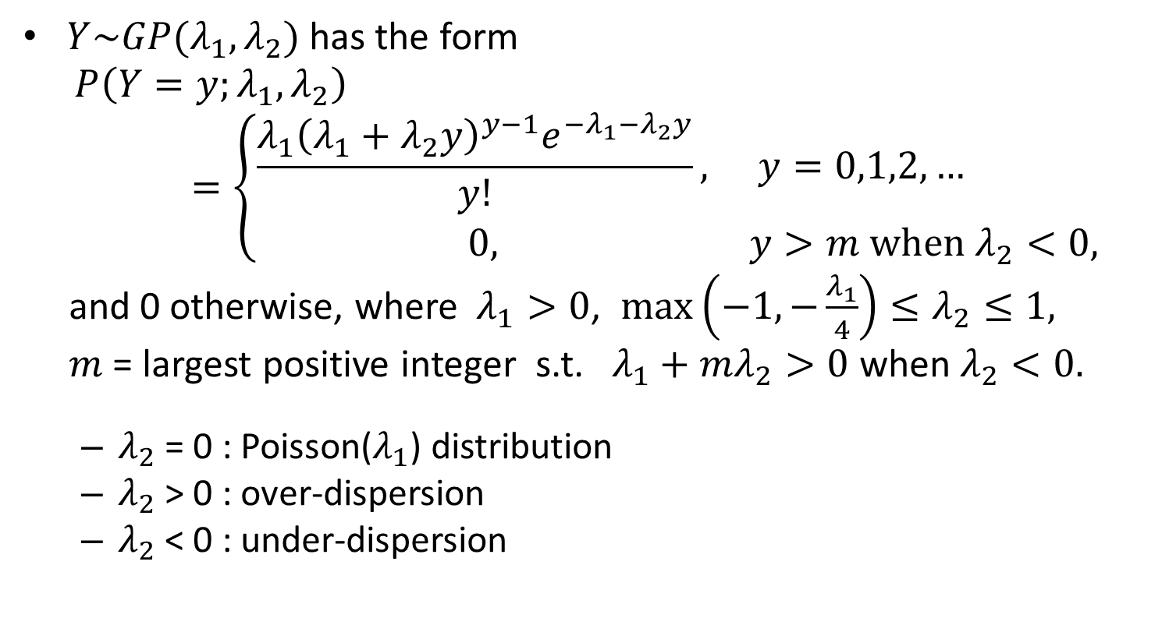
Alternative II:
Generalized Poisson Distribution
(Consul and Jain, 1973; Consul, 1989)
$Y\sim GP(λ_{1},λ_{2})$has the form
$$P\left(Y=y;λ_{1},λ_{2}\right)=\left\{\begin{matrix}\frac{λ_{1}{\left(λ_{1}+λ_{2}y\right)}^{y−1}e^{−λ_{1}−λ_{2}y}}{y!}, & y=0,1,2,… \\ 0, & y>m when λ_{2}<0,\end{matrix}\right.$$
and 0 otherwise, where$λ_{1}>0$, $\max\left(−1,−\frac{λ_{1}}{4}\right)≤λ_{2}≤1,$
$m$ = largest positive integer s.t. $λ_{1}+mλ_{2}>0$ when $λ_{2}<0.$
  $λ_{2}$ = 0 : Poisson($λ_{1}$) distribution
  $λ_{2}$> 0 : over-dispersion
  $λ_{2}$ < 0 : under-dispersion

Slide 7
Alternative II:
Generalized Poisson Distribution
Generalized model developments:
  Regression model (Famoye, 1993; Famoye and Wang, 2004)
  Control charts (Famoye, 2007)
  Model for misreporting (Neubauer and Djuras, 2008; Pararai et al., 2010)
Disadvantage:
  Unable to capture some levels of dispersion
  Distribution truncated under certain conditions with dispersion parameter ⇒ not a true probability model
Introducing the Conway-Maxwell-Poisson
(COM-Poisson) distribution

Slide 8
The COM-Poisson Distribution
(Conway and Maxwell, 1961; Shmueli et al., 2005)
pmf for rv Y ~ COM-Poisson($λ,ν$):
$$P\left(Y=y\right)=\frac{λ^{y}}{{\left(y!\right)}^{ν}Z(λ,ν)}, y=0,1,2,….$$
where $Z\left(λ,ν\right)=\sum_{j=0}^{∞}{\frac{λ^{j}}{{\left(j!\right)}^{ν}}}; v≥0$
Special cases:
  Poisson (ν = 1)
  geometric (ν = 0, λ < 1)
  Bernoulli $\left(ν→∞ with probability \frac{λ}{1+λ}\right)$

Slide 9
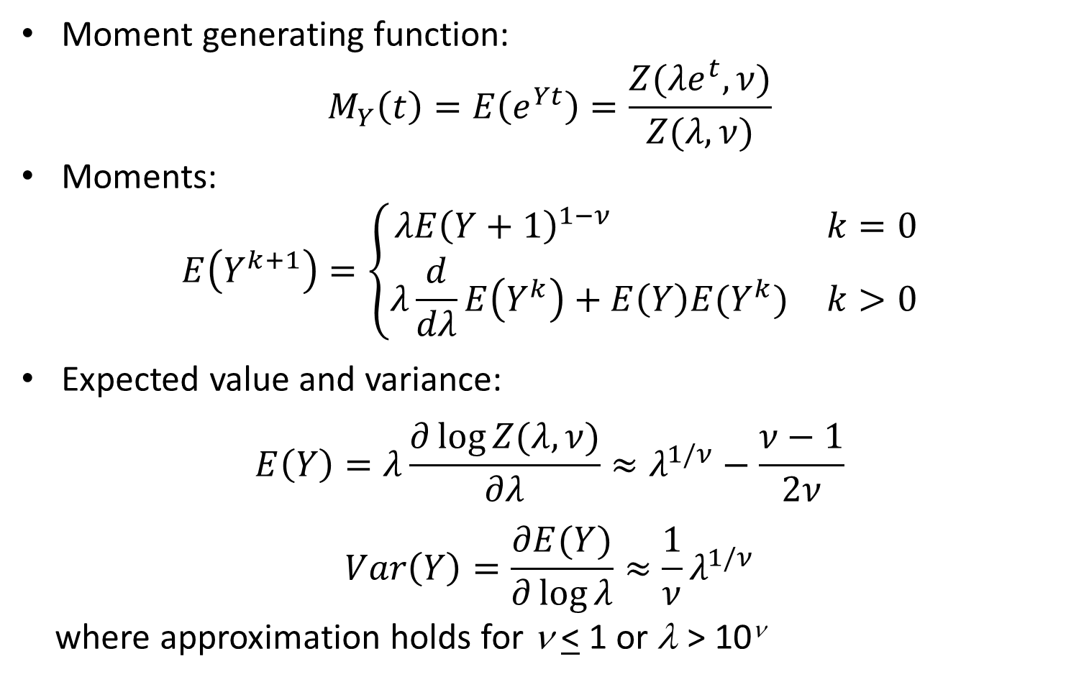
COM-Poisson Distribution Properties
Moment generating function:
$$M_{Y}\left(t\right)=E\left(e^{Yt}\right)=\frac{Z(λe^{t},ν)}{Z(λ,ν)}$$
Moments:
$$E\left(Y^{k+1}\right)=\left\{\begin{matrix}λE{\left(Y+1\right)}^{1−ν} & k=0 \\ λ\frac{d}{dλ}E\left(Y^{k}\right)+E\left(Y\right)E(Y^{k}) & k>0\end{matrix}\right.$$
Expected value and variance:
$$E\left(Y\right)=λ\frac{∂\log{Z(λ,ν)}}{∂λ}≈λ^{1/ν}−\frac{ν−1}{2ν}$$
$$Var\left(Y\right)=\frac{∂E(Y)}{∂\log{λ}}≈\frac{1}{ν}λ^{1/ν}$$
where approximation holds for ν < 1 or λ > 10^{ν}

Slide 10

COM-Poisson Distribution Properties
Has exponential family form
Ratio between probabilities of consecutive values is

Slide 11
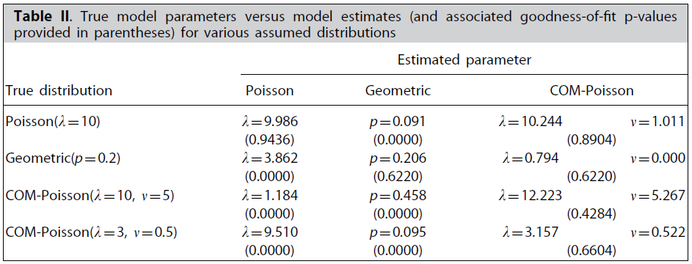
COM-Poisson Distribution Properties
Simulation studies demonstrate COM-Poisson flexibility
  Table II assesses goodness of fit on simulated data of size 500

Slide 12
COM-Poisson Probabilistic and Statistical Implications
Distribution theory (Shmueli et al., 2005; Sellers, 2012)
Regression analysis (Lord et al., 2008; Sellers and Shmueli, 2010 including COMPoissonReg package in R; Sellers and Shmueli, 2011)
Multivariate data analysis (Sellers and Balakrishnan, 2012)
Control chart theory (Sellers, 2011)
Risk analysis (Guikema and Coffelt, 2008)

Slide 13
COM-Poisson Applications
Linguistics: fitting word lengths (Wimmer et al., 1994)
Marketing and eCommerce: modeling online sales (Boatwright et al., 2003; Borle et al., 2006); modeling customer behavior (Borle et al., 2007)
Transportation: modeling number of accidents (Lord et al., 2008)
Biology: Ridout et al. (2004)
Disclosure limitation: Kadane et al. (2006)

Slide 14
How do these distributions impact control chart theory development?
Shewhart c- and u-charts’ equi-dispersion assumption limiting
  Over-dispersed data ⇒ false out-of-control detections when using Poisson limit bounds
    Negative binomial chart: Sheaffer and Leavenworth (1976)
    Geometric control chart: Kaminsky et al. (1992)
  Under-dispersion: Poisson limit bounds too broad, potential false negatives; out-of-control states may (for example) require a longer study period to be detected.
    Generalized Poisson control chart: Famoye (2007)

Slide 15
How do these distributions impact control chart theory development? (cont.)
Conway-Maxwell-Poisson (COM-Poisson) control charts accommodate over- or under-dispersion
Generalizes c- and u-charts (derived by Poisson distribution), as well as np- and p-charts (Bernoulli), and g- and h-charts (geometric)

Slide 16
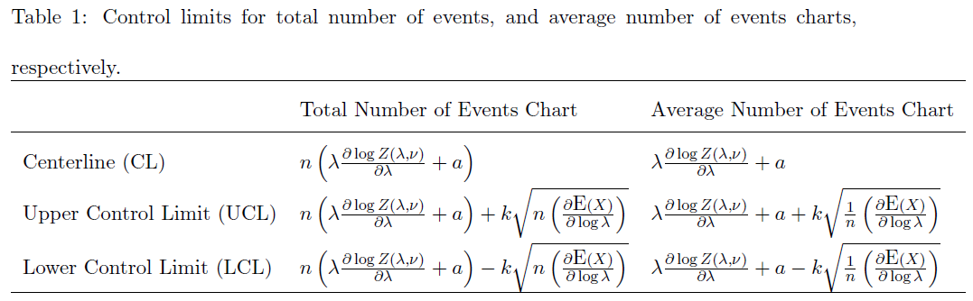
COM-Poisson Control Charts
(Sellers, 2011)
Control chart development uses shifted COM-Poisson distribution
Computations and point estimation determined using compoisson and COMPoissonReg in R

Slide 17
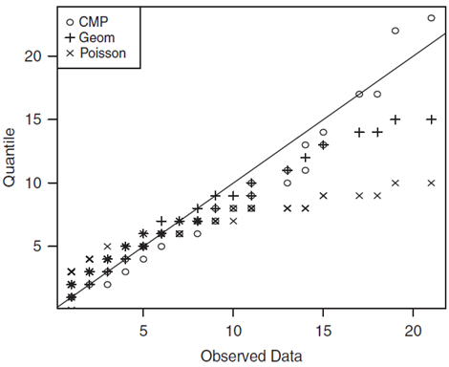
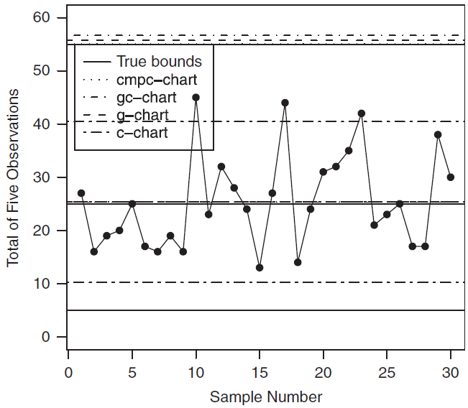
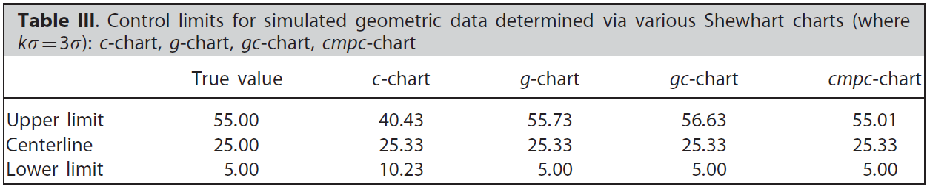
g-chart Comparison Example
(overdispersion)

Slide 18
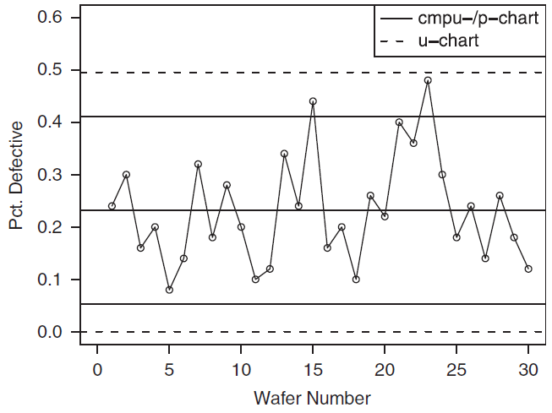
p-chart Parity
[(Extreme) underdispersion]

Slide 19
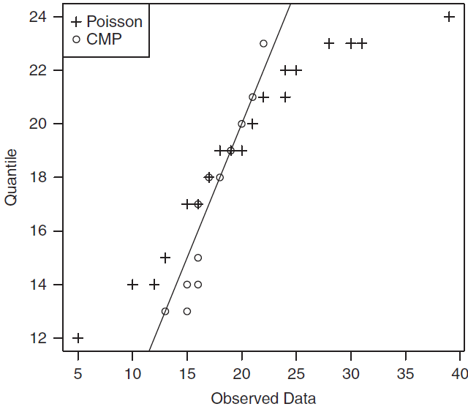
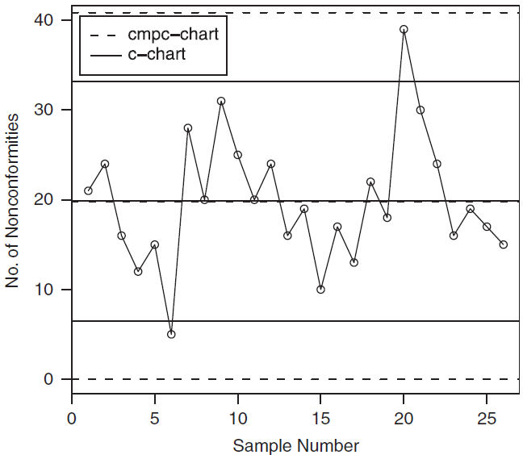
To c or not to c? (chart, that is)
Moral: Use historical in-control data to determine the control limits!

Slide 20
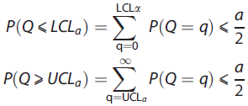
Discussion
Flexible method encompassing classical control charts
Amount of dispersion influences bound size
Limits shown here based on 3σ rule
  Saghir et al. (2012) took my advice! They consider probability limits of the following form and study its impact :
R package in progress

Slide 21
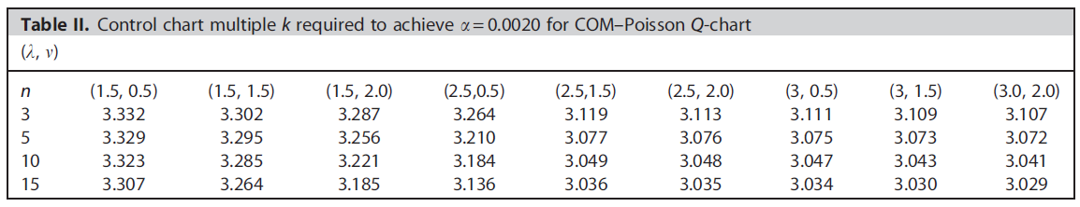
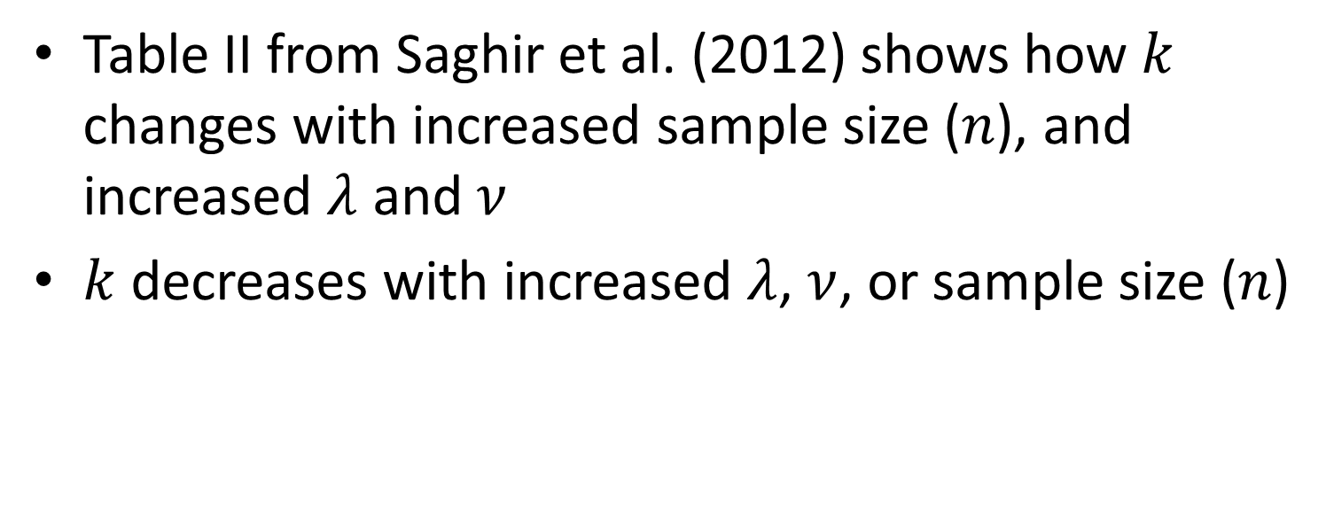

Discussion: Required $k$ limit
Table II from Saghir et al. (2012) shows how $k$ changes with increased sample size ($n$), and increased $λ$ and $ν$
$k$ decreases with increased $λ$, $ν$, or sample size ($n$)

Slide 22
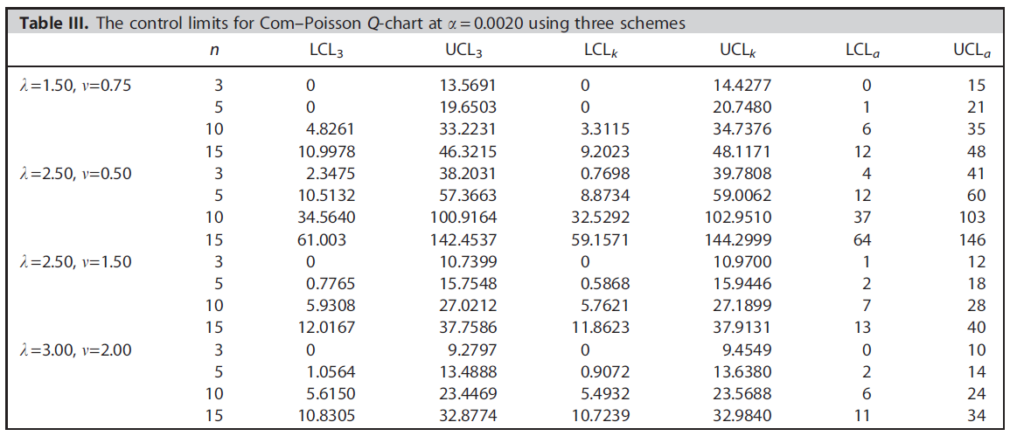
Discussion: Limit Comparisons

Slide 23
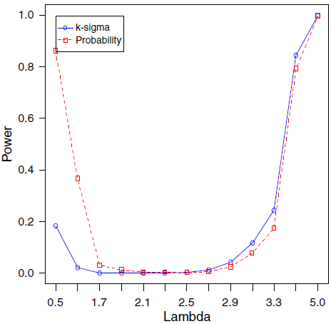
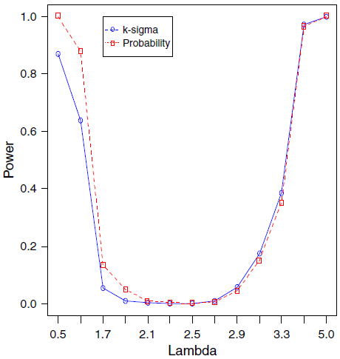
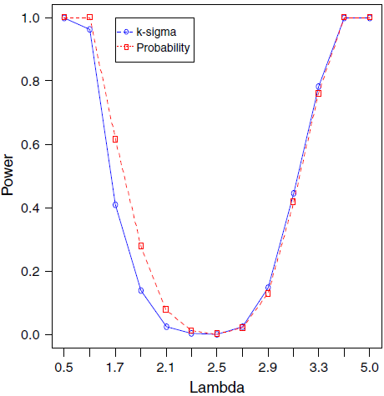
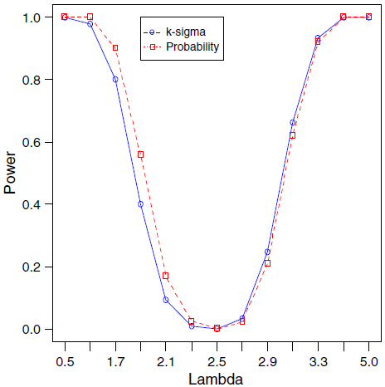
Discussion: Power Curve Comparisons

Slide 24
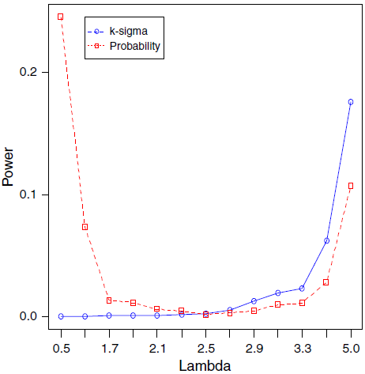
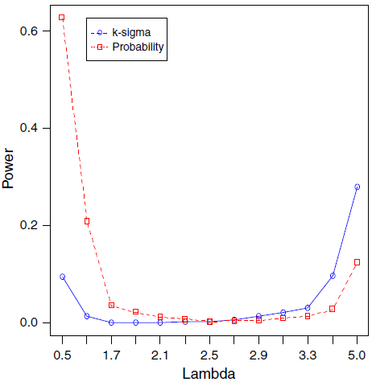
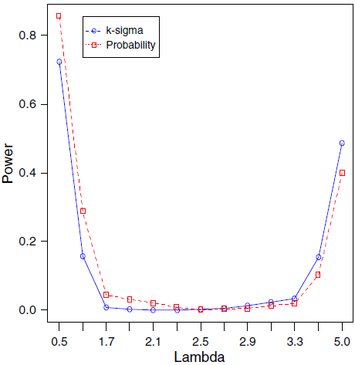
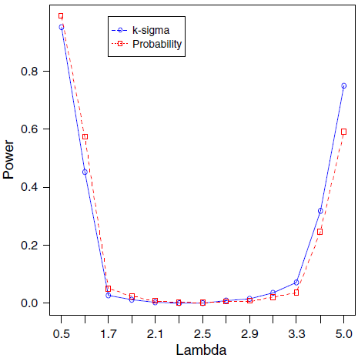
Discussion: Power Curve Comparisons
(cont.)

Slide 25
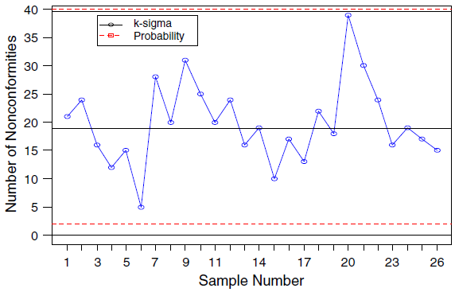
Discussion: To c or not to c? (cont.)

Slide 26
Selected References
Consul PC (1989) Generalized Poisson Distributions: Properties and Applications, Marcel Dekker Inc.
Conway RW, Maxwell WL (1961) A queueing model with state dependent service rate, The Journal of Industrial Engineering, 12(2):132-136.
Famoye F (1994) Statistical control charts for shifted Generalized Poisson distribution. Journal of the Italian Statistical Society, 3:339-354.
Kaminsky FC, Benneyan JC, Davis RD, Burke RJ (1992). Statistical control charts based on a geometric distribution. Journal of Quality Technology, 24(2):63-69.
Saghir A, Lin Z, Abbasi SA, Ahmad S (2012) The Use of Probability Limits of COM-Poisson Charts and their Applications, Quality and Reliability Engineering International, doi: 10.1002/qre.1426
Sellers KF (2011) A generalized statistical control chart for over- or under-dispersed data, Quality Reliability Engineering International, 28 (1), 59-65.
Shmueli G, Minka TP, Kadane JB, Borle S, Boatwright P (2005). A useful distribution for fitting discrete data: revival of the Conway-Maxwell-Poisson distribution. Applied Statistics, 54:127-142.

