Slide 1
Uncertainty Quantification for Turbulent Reacting Flows
James Glimm^{1,3}
Stony Brook University
With thanks to:
Wurigen Bo¹, Gui-Qiang Chen⁴, Xiangmin Jiao¹, Tulin. Kaman¹, Hyun-Kyung Lim¹, Xaolin Li¹, Roman Samulyak^{1,3}, David H. Sharp², Yan Yu¹
1. SUNY at Stony Brook
2. Los Alamos National Laboratory
3. Brookhaven National Laboratory
4. Oxford University

Slide 2
Turbulence
Mixing
  Instabilities generated by acceleration
  Two or more fluids in (turbulent) flow
    Hot-cold water; salt-fresh water; oil-water
    Rayleigh-Taylor, Couette, Richtmyer-Meshkov
Turbulent combustion
  H₂ flame in engine of a scram jet
Multiscale issue
  DNS vs. LES vs. RANS
    LES: resolve some but not all turbulent scales; model the rest

Slide 3
Models and numerical analysis
LES depends on models
  Fluctuations at a sub grid level influence computation at the grid level; is approximated; hence the model.
Models: generally largest source of simulation error and uncertainty

Slide 4
Main Results and
Near Future Term Plans
Reformulate notions of convergence
    To reflect stochastic nature of turbulent simulations
Eliminate (some) models (where possible)
Assess errors associated with (remaining) models
New analysis of experimental data
  UQ for turbulent mixing

Slide 5
I.
Stochastic convergence for stochastic problems

Slide 6
LES regime
Laminar viscosity/mass diffusion: small
  Equations are Euler like
Unresolved terms (and models) are diffusive
  Solutions are Navier-Stokes like

Slide 7
Higher Dimensional Existence/Uniqueness Theory
  Existence:
    Theorem (Gangbo and Westdickenberg):
      Existence of solutions as measured valued functions
      Limit not proved to satisfy the original equation
  Nonuniqueness:
    Scheffer (1989), Shnirelman, DeLellis and Szelkelyhidi (Archives), Volker Elling (numerical), Lopez, Lopez, Lowengrub and Zheng (numerical)
    These (D&S) are classical weak solutions.

Slide 8
A mathematical theorem
(G-Q Chen, JG)
Incompressible Euler equations
  Assume Kolmogorov 1941 turbulence bounds
    Fluctuations in velocity satisfy an integrable power law decay
    Thus velocity belongs to a Sobolev space
    Bounds and convergence (through a subsequence) to a classical weak solution
With passive scalar (mixing)
  Volume fractions w* convergent (subsequences), as a pdf to a pdf limit, i.e. a Young measure solution of the concentration equation coupled incompressible Euler solution

Slide 9
Weak vs. pdf (Young measure) solutions
Weak solution
  No subgrid fluctuations
  Nonlinear functions not preserved in the limit
  Nonlinear processes (chemistry) require additional terms (models) to account for the missing fluctuations
pdf (Young measure) limit
  Fluctuations and nonlinear functions preserved.

Slide 10
Classical vs. Young measure (stochastic) convergence
Integral of numerical solution u_{n} with test function g converges to limit
w* convergence in
  Values of g multiply primitive variables: density, energy, … in R^{m}
  Argument of g = space, time
    integation over space time
  g(x,t) multiplies density, energy, …
w* convergence in
  Values of g multiply probabilities
  Argument of g = space, time, density, energy, …
    Integration over space, time, random density, energy, momentum, …
  g(x,t,random density,…) multiplies probability

Slide 11
Young Measure of a Single Simulation
Coarse grain and sample
  Coarse grid = block of n⁴ elementary space time grid blocks. (coarse graining with a factor of n)
  All state values within one coarse grid block define an ensemble, i.e., a pdf
  Pdf depends on the location of the coarse grid block, thus is space time dependent, i.e. a numerically defined Young measure

Slide 12
Convergence of Pdfs
w* convergence: multiply by a test function and integrate
  Test function depends on x,t and on (random) state variables
Integrate once, the indefinite integral is the probability distribution function
  Apply conventional metrics to the probability distribution functions (L₁, L_{infty}, …)

Slide 13
II.
Eliminate (some) models by use of stochastic convergence

Slide 14
Turbulent Combustion
LES with finite rate chemistry
w* convergence with stochastic integration over random
variables extends to all nonlinear functions of the solution.
Chemical reaction source terms converge
Coupling to other nonlinear physical processes converge as well
For chemistry (H₂ flame in scram jet)
turbulence scale (Kolmogorov) = 5-10 microns
<< grid scale = 60-100 microns
<< chemistry scale = 300 microns

Slide 15
Scram Jet
Chemistry can be computed directly (without models)
in an LES simulation
Removes chemistry model from turbulent combustion
Only turbulent fluid transport models needed
Model form uncertainty (epistemic : most difficult) eliminated

Slide 16
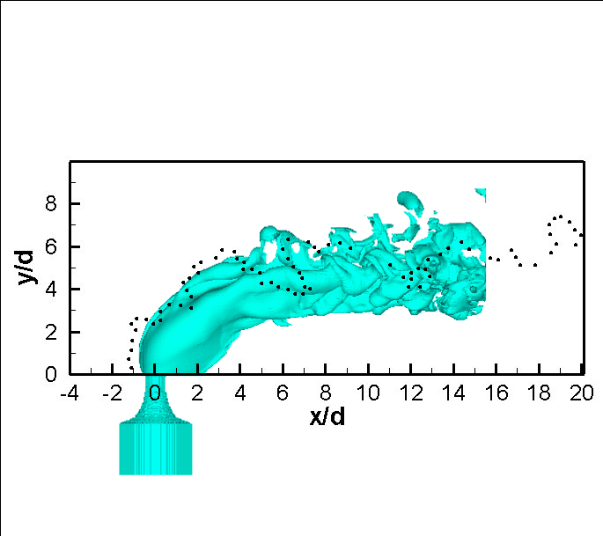
Scram jet: H₂ injection into M = 2.4 cross flow: Mixing Only
Black dots are the flame front
extracted from the experimental
OH-PLIF image.
Notes:
16

Slide 17
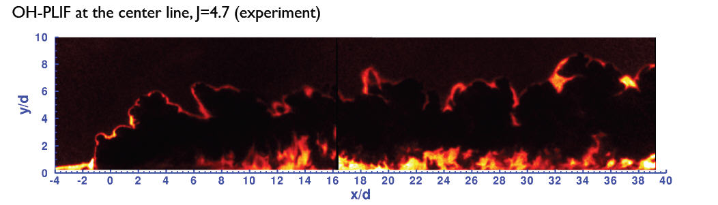
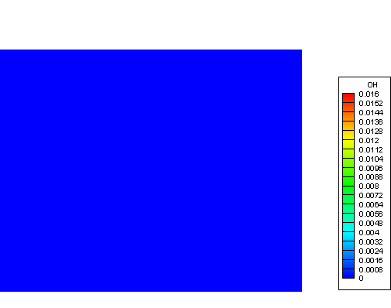
OH radical density indicating internal layer in H₂ flame

Slide 18
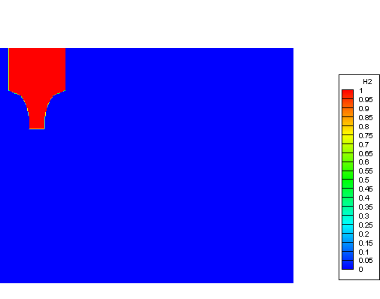
H₂ fuel density in center plane through flame

Slide 19
III.
Assess model error

Slide 20
Numerical tests of theory
Subgrid scale models for unresolved LES scales
Tracking limits numerical mass diffusion
Stochastic convergence

Slide 21
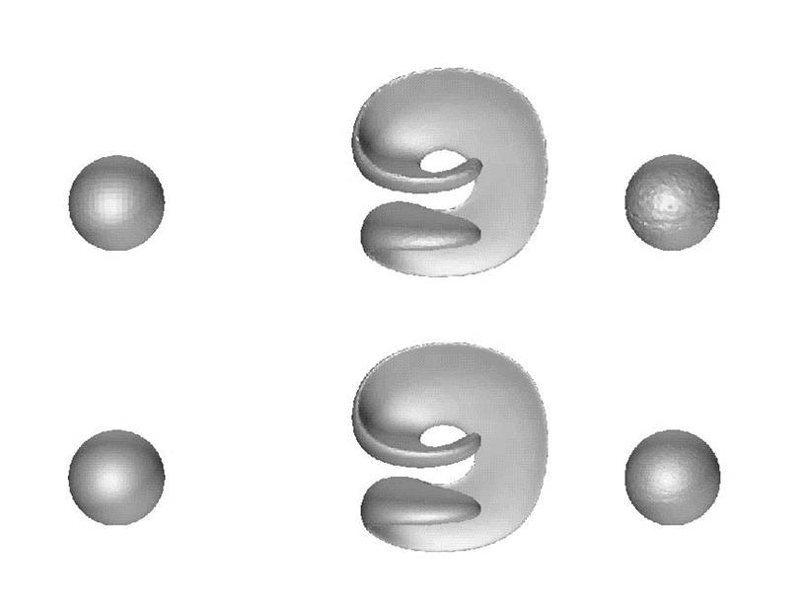

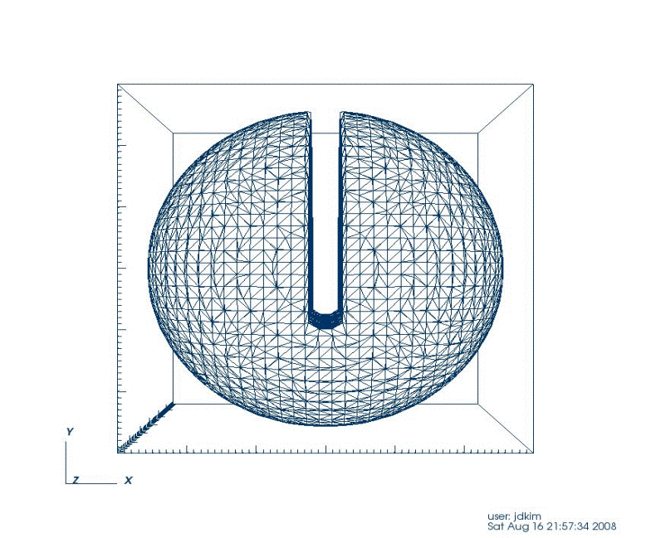

Geometry preservation, accuracy and high
(subgrid) resolution
64x64x64
2D
128x128x128
Accuracy
3D
Geometry preservation
Subgrid resolution

Slide 22
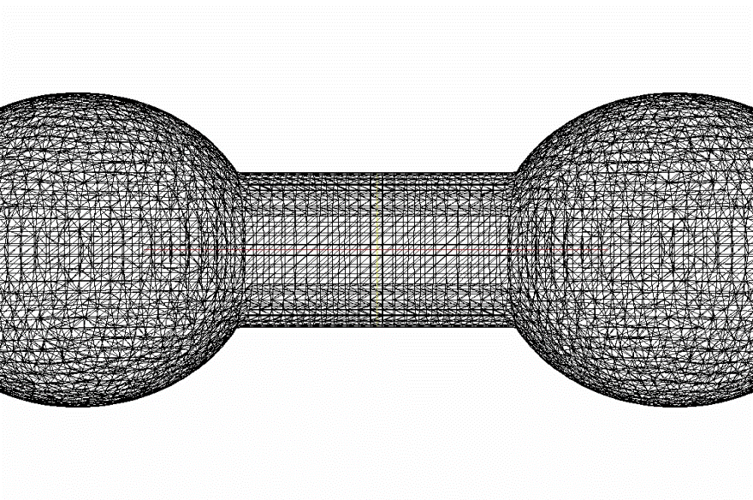
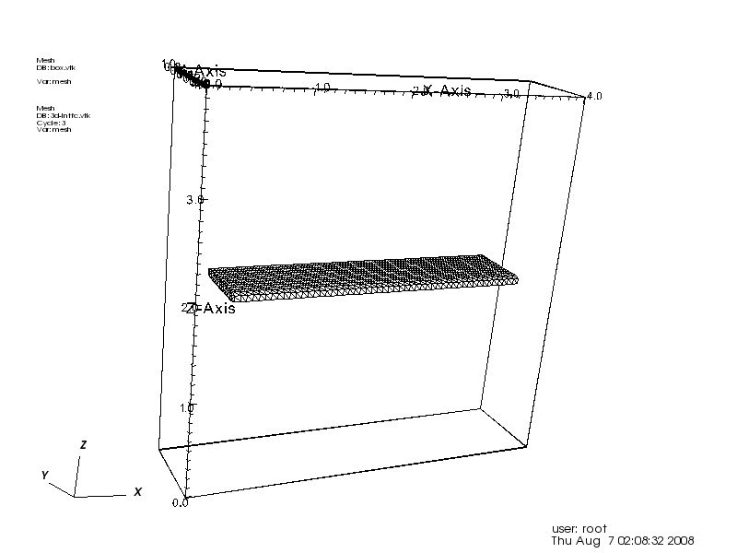
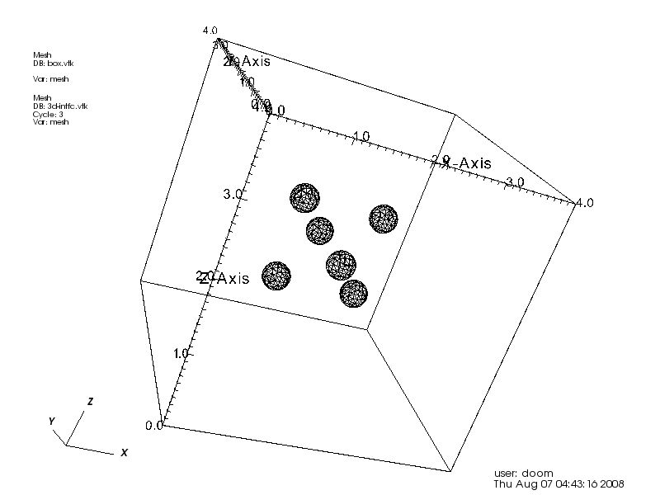
Robust geometry and topology functions
Robust topological bifurcation
Efficient mesh deformation
Robust mesh merging

Slide 23
Subgrid models for turbulence, etc.
Typical equations have the form
Averaged equations:
is the subgrid scale model and corrects for grid errors

Slide 24
Subgrid models for turbulent flow

Slide 25
Application based testing
Hydro instabilities
  Rayleigh-Taylor and Richtmyer-Meshkov
    ICF applications
Turbulent mixing and combustion
  Scram jet applications
Mixing in Couette flow
  Spent nuclear fuel separation
Crystal growth
  Nuclear fuel processing; porous media applications
Diesel spray
  Droplet size in primary jet beakup

Slide 26
Rayleigh-Taylor Instable Mixing
Light fluid accelerates heavy
  Across a density contrast interface
Overall growth of mixing region
Molecular mixing: second moment of concentration

Slide 27
Simulation study of RT alpha for
Smeeton-Youngs experiment #112
Agreement with experiment (validation)
Agreement under mesh refinement (verification)
Agreement under statistical refinement (verification)
Agreement with Andrews-Mueschke-Schilling (code comparison; different experiment)
Agreement within error bounds established for uncertain initial conditions (uncertainty quantification)

Slide 28
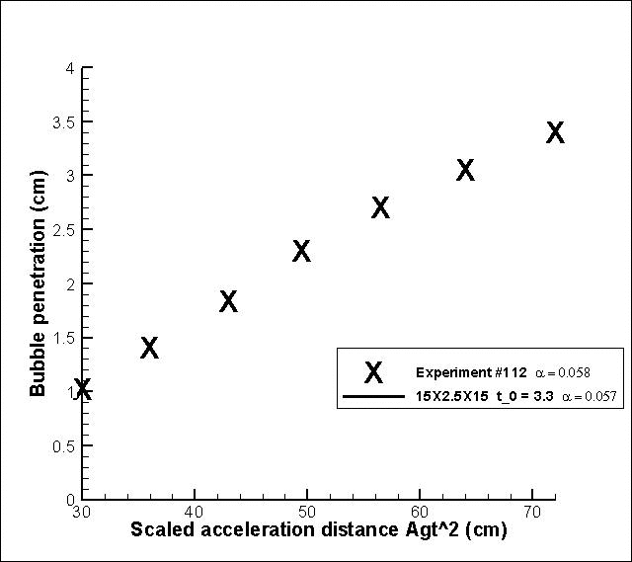
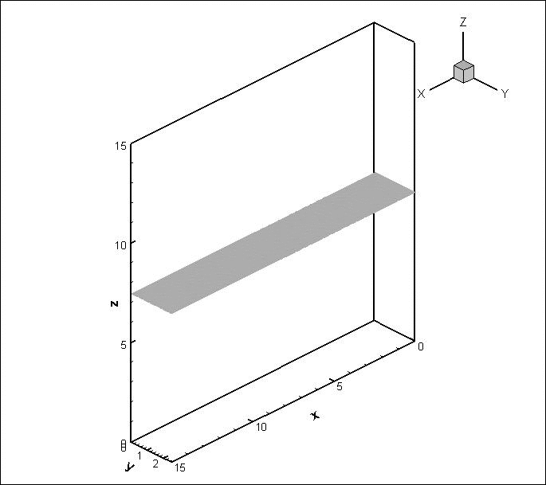
Simulation-Experiment
Comparison
Experiment : V. S. Smeeton and D. L. Youngs, Experimental investigation of turbulent mixing by
Rayleigh-Taylor instability (part 3). AWE Report Number 0 35/87, 1987
Simulation : H. Lim, J. Iwerks, J. Glimm, and D. H. Sharp, Nonideal Rayleigh-Taylor Mixing
The simulations reported here were performed on New York Blue, the BG/L computer operated jointly by Stony Brook University and BNL.
Notes:
28

Slide 29
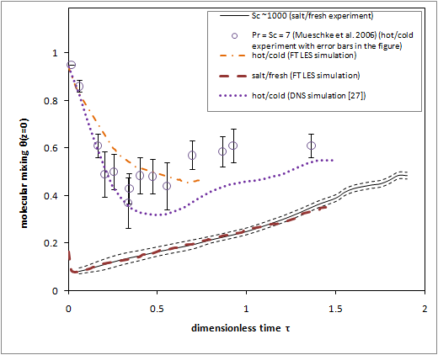
Molecular level mixing: second moment of concentration
2 experiments, 3 simulations (one DNS) compared

Slide 30
Richtmyer Meshkov Instability
Circular domain, perturbed circular interface
  Ingoing circular shock passes through interface, causes instability
  Reaches origin, reflects there, recrosses (reshocks) perturbed interface
High level of chaotic mixing results
Convergence of pdfs of concentrations shown
  L₁ norm of distribution functions

Slide 31
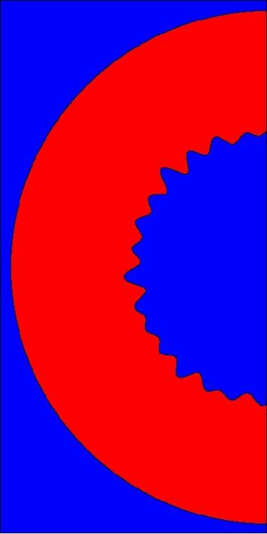
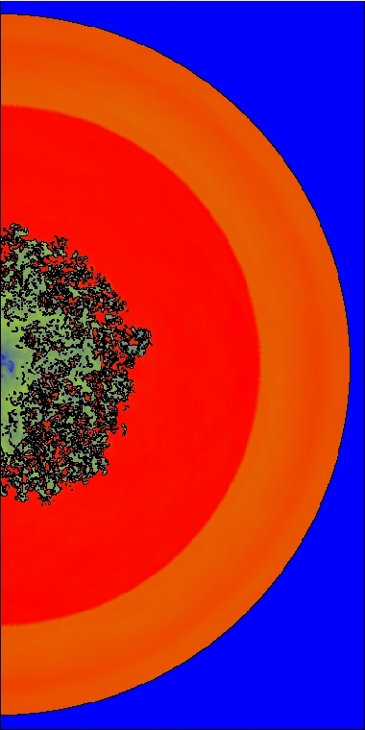
Circular
RM instability
Initial (left)
and after
reshock
(right) density
plots. Upper and
lower inserts
show enlarged
details of flow.

Slide 32
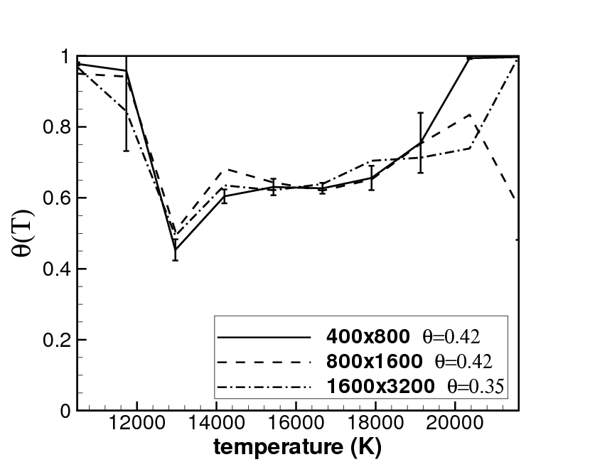
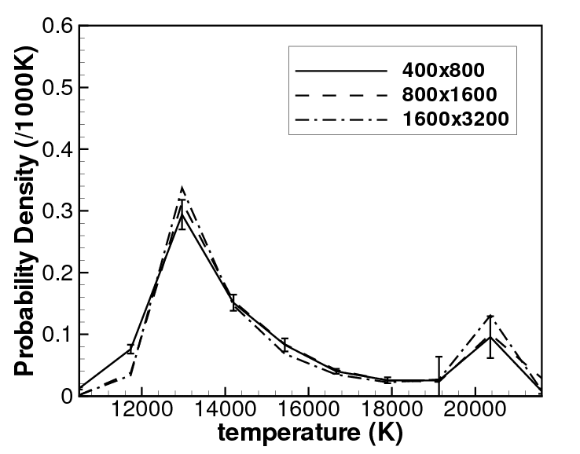
Re = 3000. Theta = normalized second moment of concentrations
Theta(T) vs. T (left); Pdf for T (right)

Slide 33
Kolmogorov-Smirnov Metric for comparison of PDFs
Sup norm of integral of PDF differences
Also L₁ norm of distribution function

Slide 34
Theoretical Model for PDFs
d = distance to computed interface
Use heat equation, d, elapsed time (since reshock), and the turbulent + laminar diffusion constant in 1D diffusion equation; predict the mixing PDF

Slide 35
Convergence, model comparison, intrinsic fluctuation for reaction rate pdf
Re | c to f | m to f | model to f
300 | 0.04 | 0.03 | 0.06
3K | 0.49 | 0.04 | 0.07
600K | 0.09 | 0.03 | 0.07

Slide 36
IV.
Uncertainty Quantification

Slide 37
1. Does simulation depend on unmeasured initial data?
Transfer data from early time to initial time
Record all bubble minima
Fourier analyze these minima
Apply linear growth law dynamics to each mode A(n) to infer initial amplitudes from early time data
Compare results from different early times for consistency

Slide 38
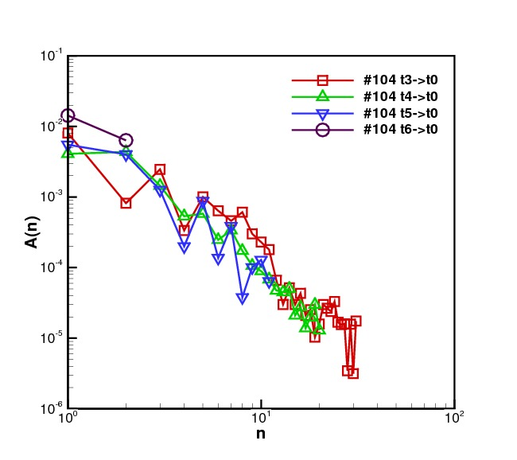
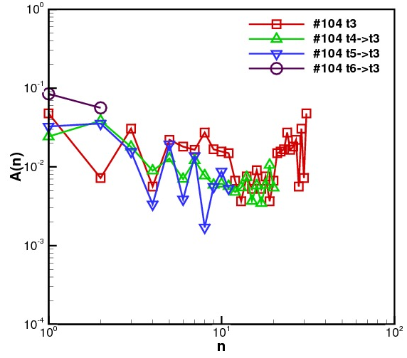
A(n) vs. wave number n at t = 0
Early time
T = 0
A(k) ~ ka with
a = 0. Omit k = 0 mode as this is the mean bubble position and is a short wave length signal.

Slide 39
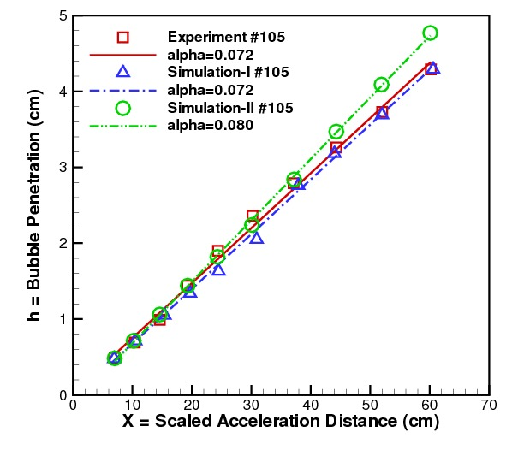
Uncertainty quantification regarding possible long wave length initial perturbations
Reconstruction of
long wave length
initial perturbations
simulated at
+/- 100% to allow
for uncertainty
in reconstruction.
Net effect: +/-5%
for alpha.

Slide 40
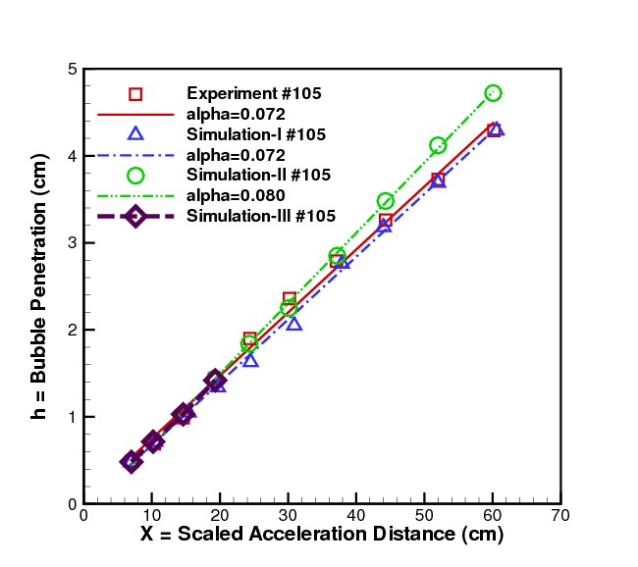
2. Possible influence of SGS models and unresolved length scales?
Mesh refinement to allow
resolution of Weber number length scale.
Simulation III. No effect on penetration distance. Partially completed.

Slide 41
3. Is large Re flow characterized by universal dimensionless parameters?
Turbulent transport dominates laminar transport
  Observed at Re = 15,000
High Re Schmidt numbers from 2D RM study
  For Re = 600K, Sc_{turbulent} = 0.38, 0.34, 0.41 (liquid, gas, plasma)
  For Re = 6000, Sc_{turbulent} = 2.0, 0.76, 0.92 (liquid, gas, plasma)
    nearly universal relative to physics (laminar transport coefficients)
    for very high Re, specific late time RM unstable flow

Slide 42
Conclusions
Reacting, turbulent, mixing flows require
  LES solutions
    Concentrations converge as Young measures
  Control over numerical mass diffusion (front tracking)
  Subgrid scale turbulence models
  Pdf convergence
  V&V+UQ
  Testing in realistic examples where “truth” is known
High Re flow is universal in Schmidt number
  Relative to changes in laminar transport properties

Slide 43
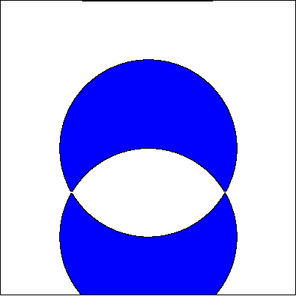
Thank You
Smiling Face: FronTier art simulation
Courtesy of Y. H. Zhao

