Slide 1
NIST SURF Presentation: Enhanced Viewing of 3D Objects Scanned using Photogrammetry
By: Mitchell Campbell
Any mention of commercial products within NIST web pages is for information only; it does not imply recommendation or endorsement by NIST.

Slide 2
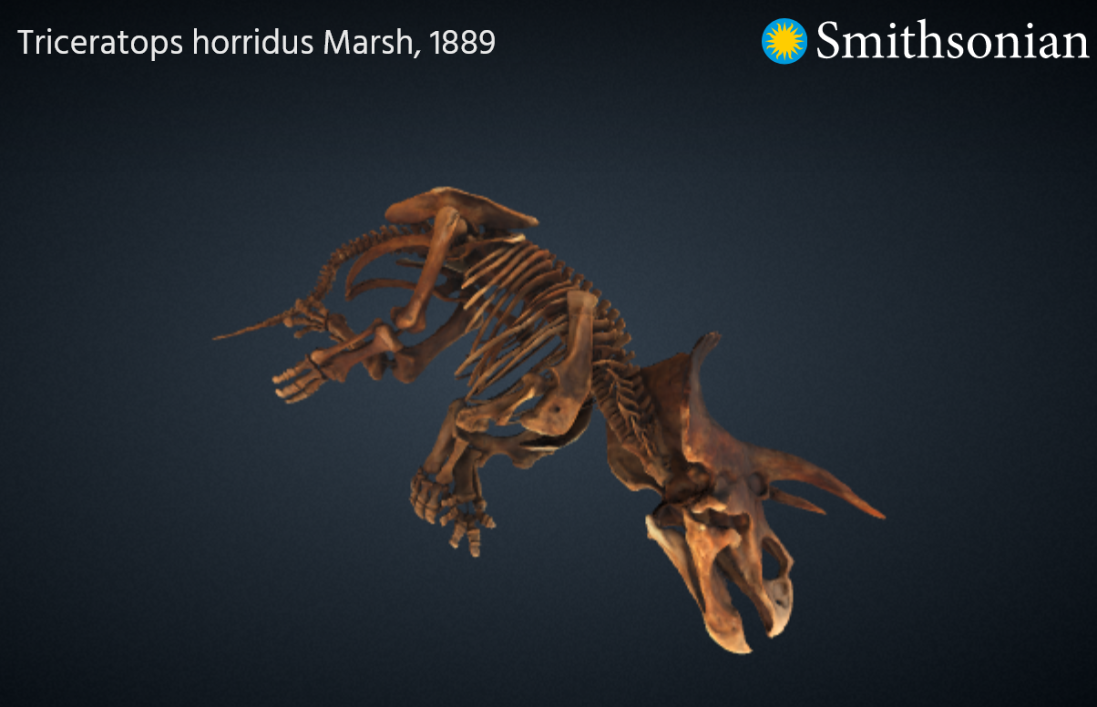
Research Purpose
Museums do not have the space to display all of their collection to the public.
As a result, museums typically have most of their collections held in storage.
Scanning museum artifacts using photogrammetry so they can be viewed as digital 3D models allows the public to view these artifacts.

Slide 3
Photogrammetry
Digital photogrammetry software constructs a virtual model mesh (a 3D object).
This is done using 3D coordinates calculated by taking pictures of an object from multiple perspectives. (we used pre-computed models)
The 3D model constructed can be saved as a gLTF file.

Slide 4
gLTF File Format
A standard file format for 3D scenes and models.
Created and managed by the Khronos Group (NIST is a member).
Just announced that it has become an ISO standard.

Slide 5
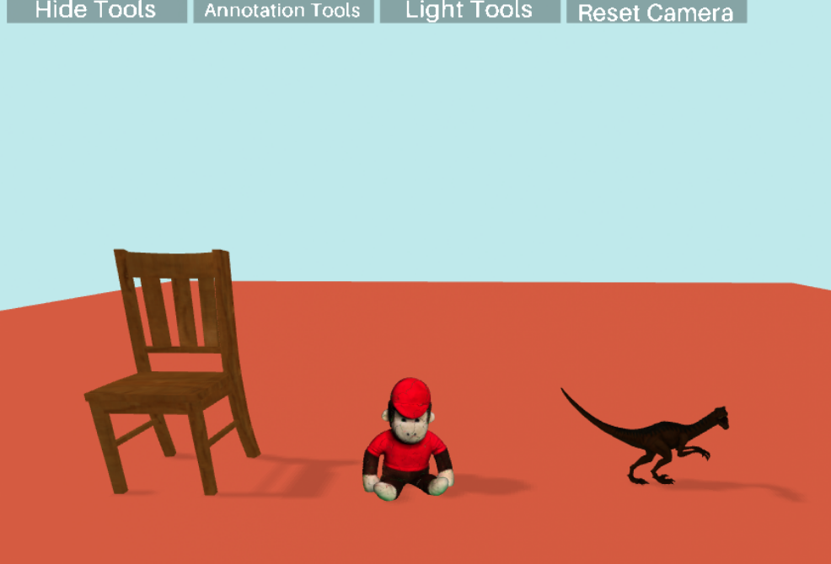
gLTF Objects in Aframe.io
A-Frame is compatible with both regular desktop 3D and Virtual Reality viewing.
Objects being viewed were created using photogrammetry and stored as a gltf/glb file. This file is then imported into A-Frame.
As a javascript library A-Frame allows us to create content directly viewable and interactive on standard web browsers.

Slide 6
Importing scanned objects into an Aframe.io scene
In my case the base material and texture meshes of a model are placed in one file before the model is imported into A-Frame.
If not already together in a file, the meshes can be imported into Blender and exported together as a gLTF file.
After the asset is successfully imported, it can be inserted into the A-Frame scene and is treated like any other A-Frame object/entity.

Slide 7
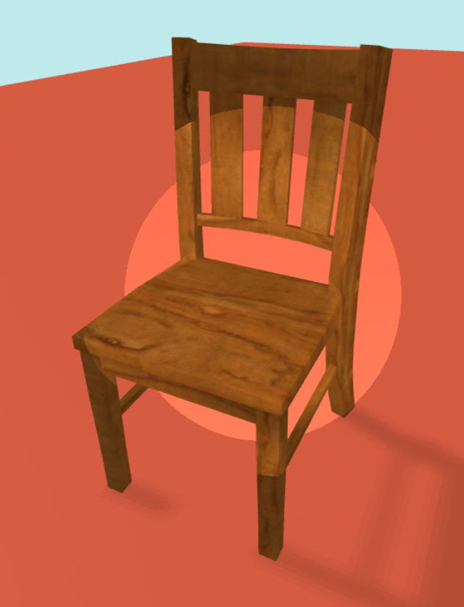
Aframe Lighting Effects
An ambient light in the 3D scene is used to give the models shadows.
A spotlight shines in the direction of the mouse cursor to brighten models. Size of the light can be increased/decreased.
Both the spotlight and shadows in the scene can be toggled on/off.

Slide 8
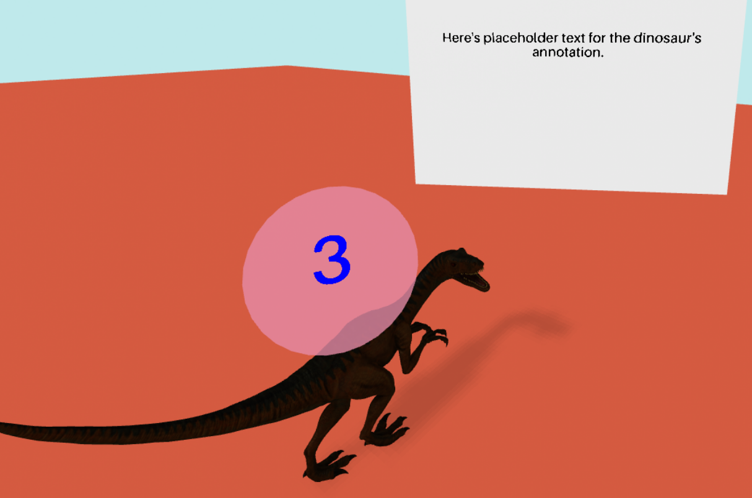
Annotations as a billboard object
Physical plane within the scene with a billboard effect.
Annotation plane (the billboard) always faces camera.
Buttons clicked by the user make annotations visible/invisible in the scene.

Slide 9
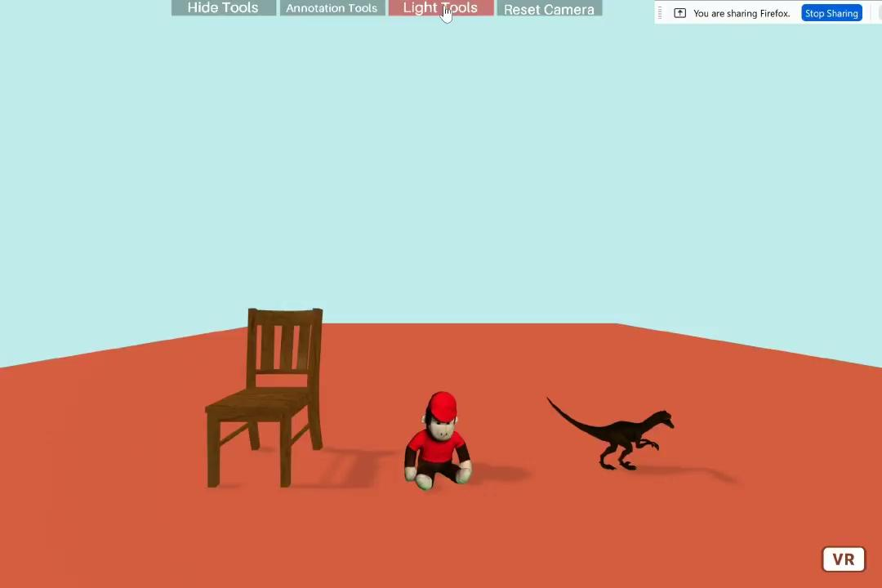

Slide 10
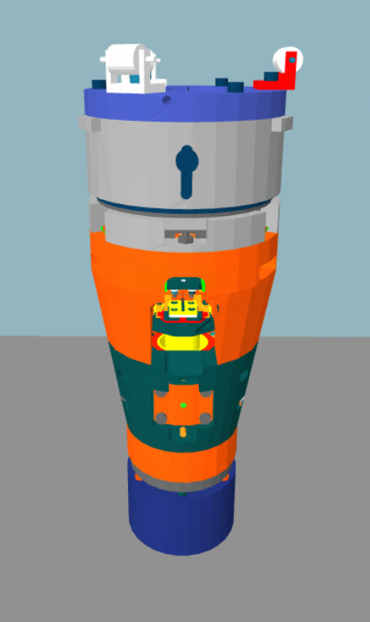
3D Scene with NIST’s Scanning Tunneling Microscope
Virtual reality simulation of a NIST scanning tunneling microscope head.
The model was created from the original CAD data many years ago.
Changes made with the purpose of looking at how the individual parts of a larger, complex object can be annotated with A-Frame.

Slide 11
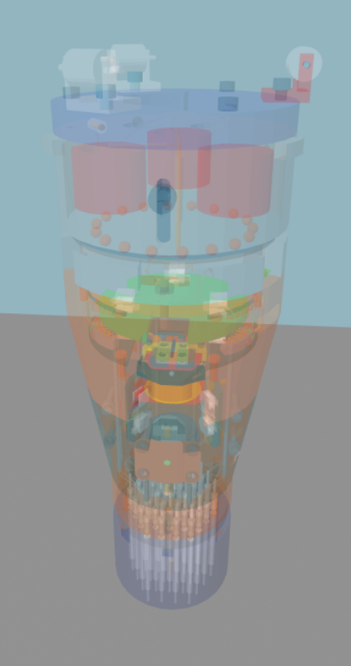
Transparent Model Visualization
Transparency (or lack thereof) is used as a visual method to highlight the parts (when moused over)
A heads-up display (HUD) displays the name and an annotation for the part currently being moused over.

Slide 12
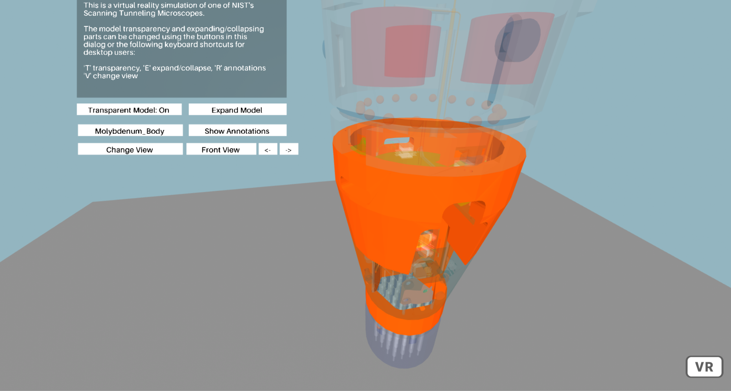
Highlighting Individual Objects
Model Name

Slide 13
Explode/Collapse View
Increased separation between microscope parts compared to original scene’s exploded view.
Supports differentiating different parts of the microscope from one another.

Slide 14
Microscope as an Exploded Model
STM Model in Exploded View
STM Model in Exploded View while Transparent

Slide 15
Microscope Annotations
Text file used as input.
Automatically scales with HUD box.
HUD box

Slide 16
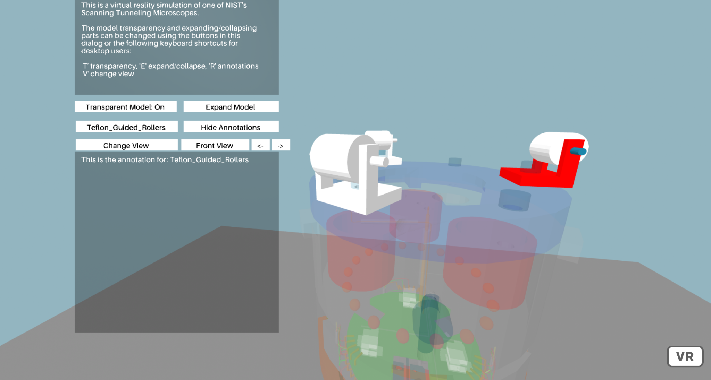

Slide 17
Camera Viewpoints
Manual camera movement by the user is often awkward with complex models.
Predefined camera viewpoints allow the user to quickly move the camera to interesting areas of a model.
There are 3 different viewpoints of the microscope head: top, front, and bottom.

Slide 18
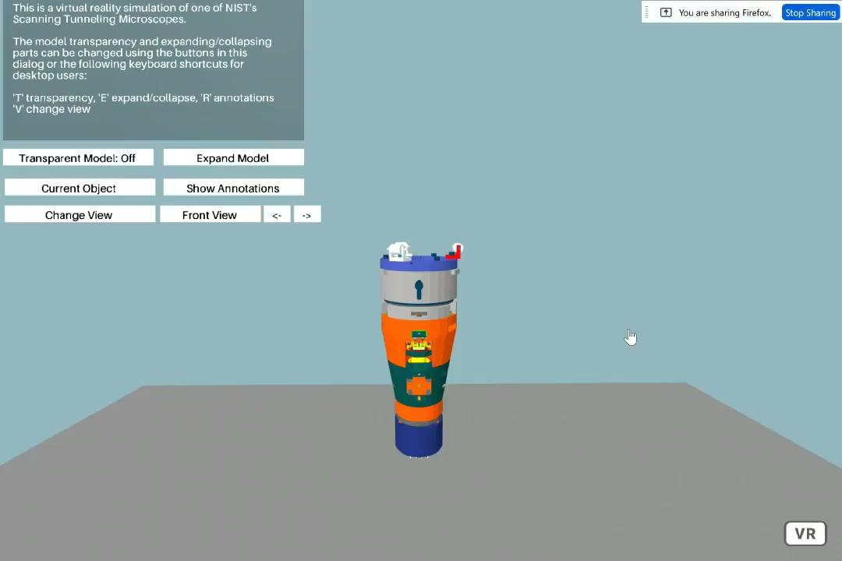

Slide 19
Keyboard Shortcuts/Controls
Allows user to control model without clicking with a mouse.
Key that toggles each tool indicated in main HUD window at top left of the A-Frame scene.
Not compatible with VR viewing of the scene.

Slide 20
Summary
Imported scanned objects into A-Frame
Created lighting effect that follows mouse cursor
Created annotations for the objects, both as a billboard and as a HUD
Annotations come from a text file, not hard coded
Made the individual parts of a transparent model highlightable
Made different viewpoints for positioning the camera

Slide 21
Conclusion
Real-world objects can be scanned using photogrammetry to create 3D models in the gLTF file format.
Lighting tools are used to improve visibility of gLTF models.
Highlighting objects in the 3D scene and adding annotations for them, help distinguish between parts of a more complex model and give the user information about each part’s purpose.
All work operates in a simple web browser, making models widely available.

Slide 22
Project Links
Scene for testing lighting effects and billboard annotations:
https://glitch.com/edit/#!/unleashed-important-juniper?path=index.html%3A1%3A0
NIST STM head scene:
https://glitch.com/edit/#!/ringed-electric-barber?path=index.html%3A1%3A0

Slide 23
Thank You
Sandy Ressler (SURF Mentor)
Yolanda Bursie
Derek Juba
Brandi Toliver
All other SURF directors

Slide 24
Questions?

